Slide 1

A-Level Maths
Mock exam analyser
7357/1
June 2022

Slide 2
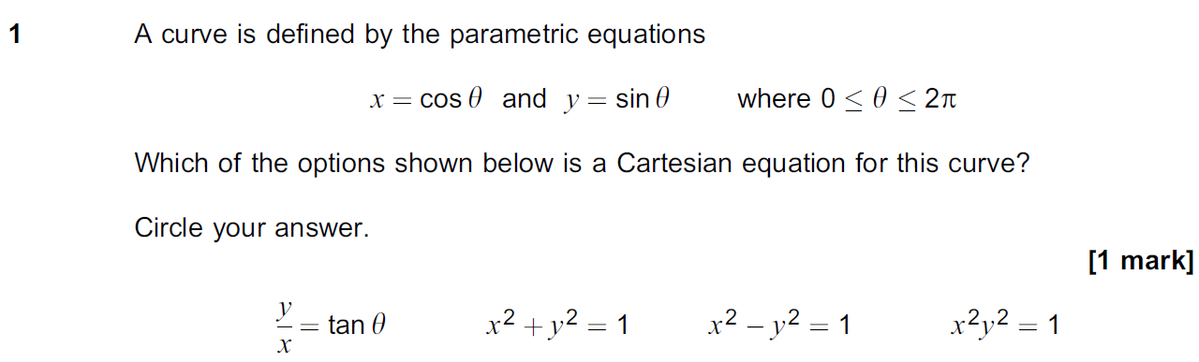
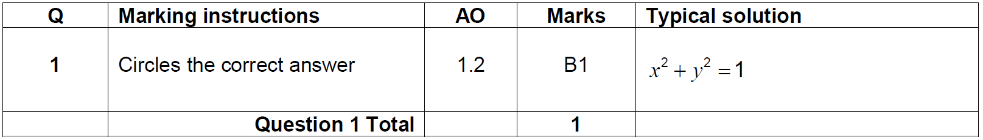
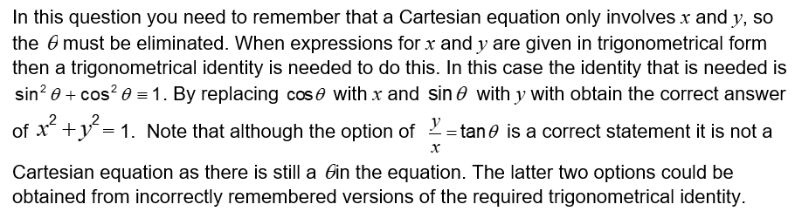
Question 1
Question | Mark scheme
The examiner says

Slide 3
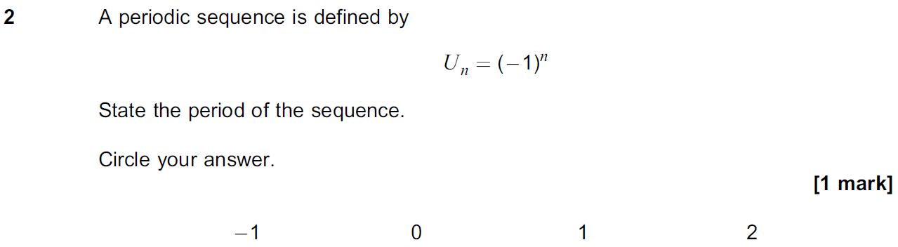
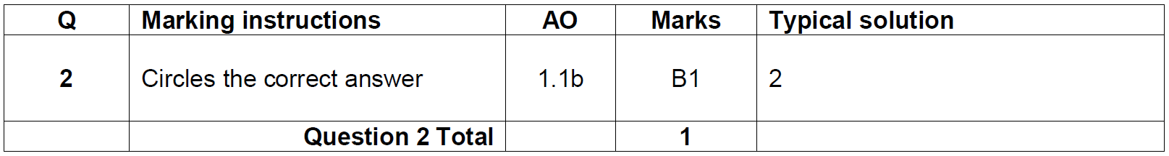
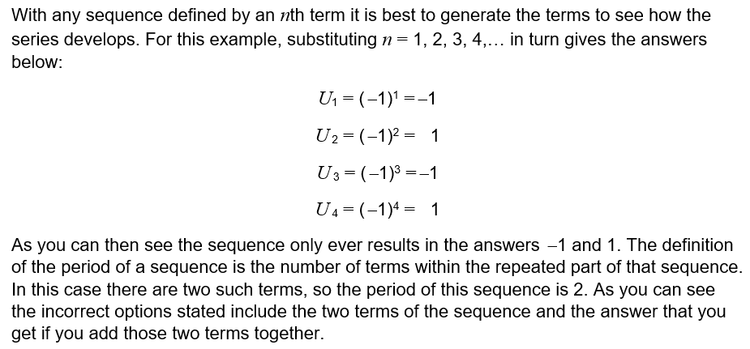
Question 2
Question | Mark scheme
The examiner says

Slide 4
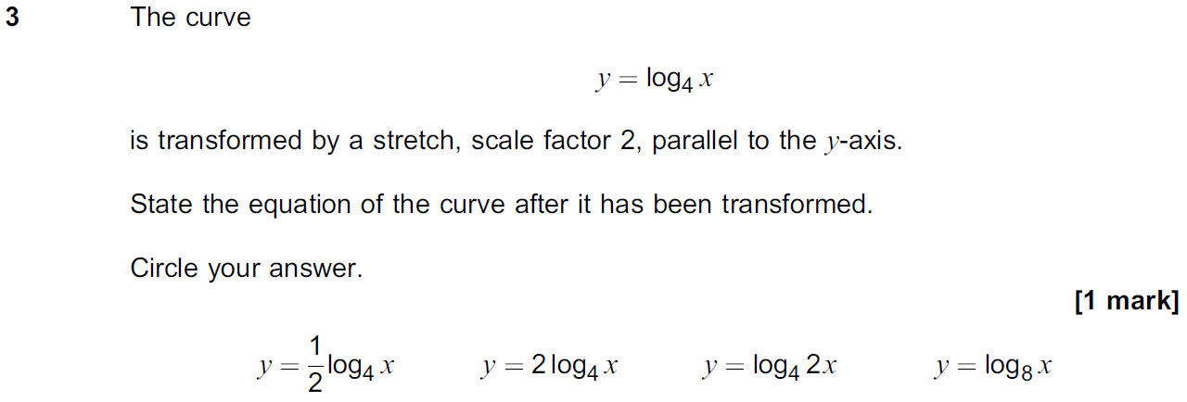
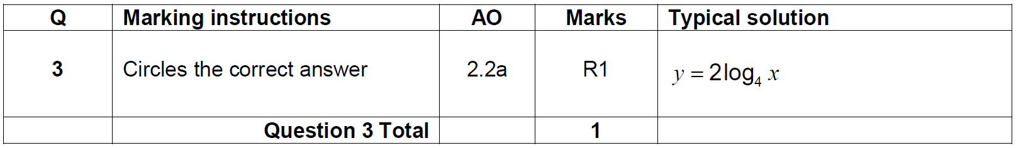
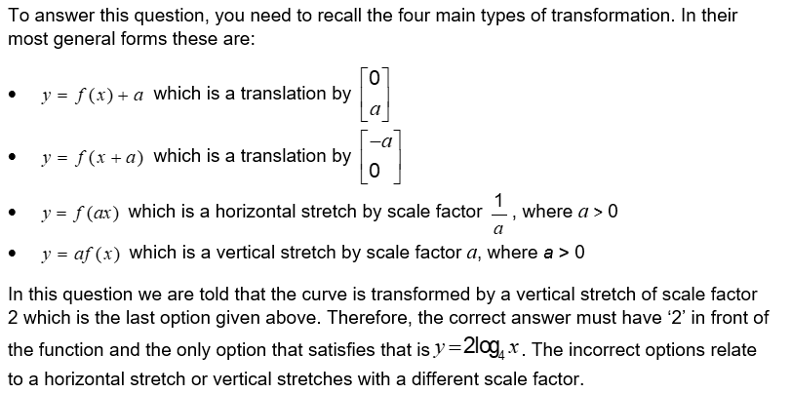
Question 3
Question | Mark scheme
The examiner says

Slide 5
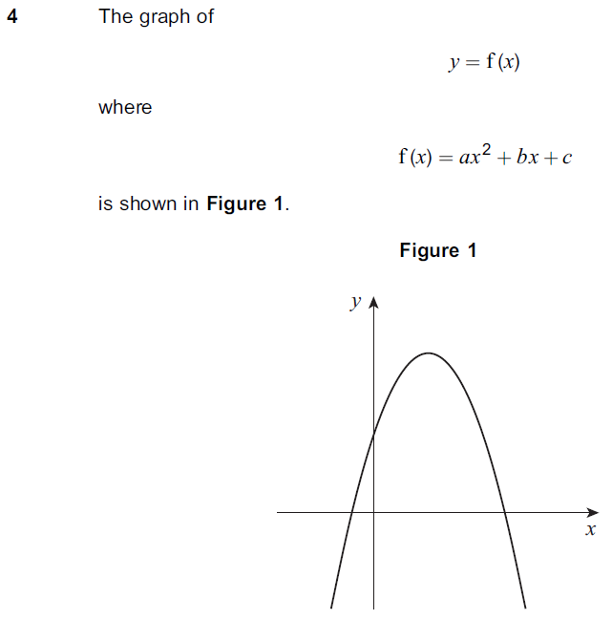
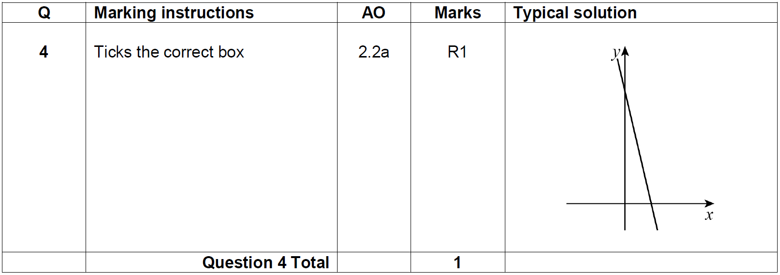
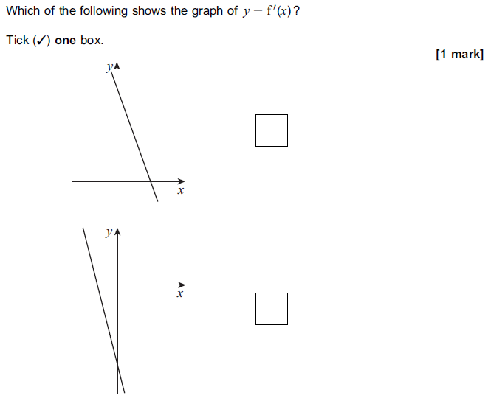
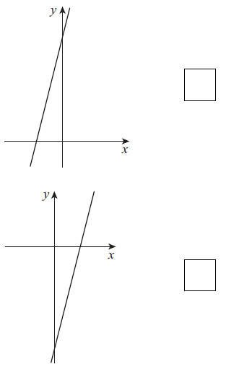

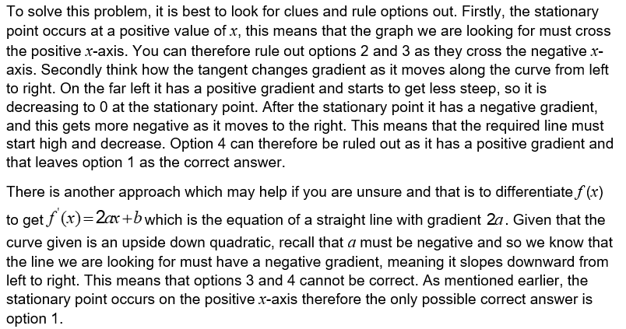
Question 4
Question | Mark scheme
 | The examiner says

Slide 6
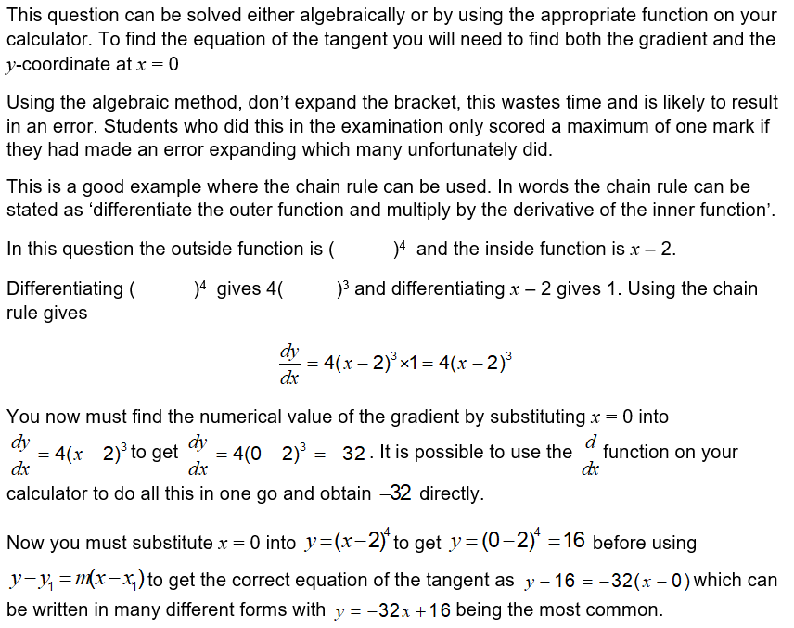
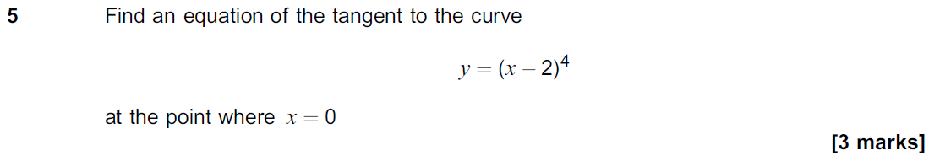
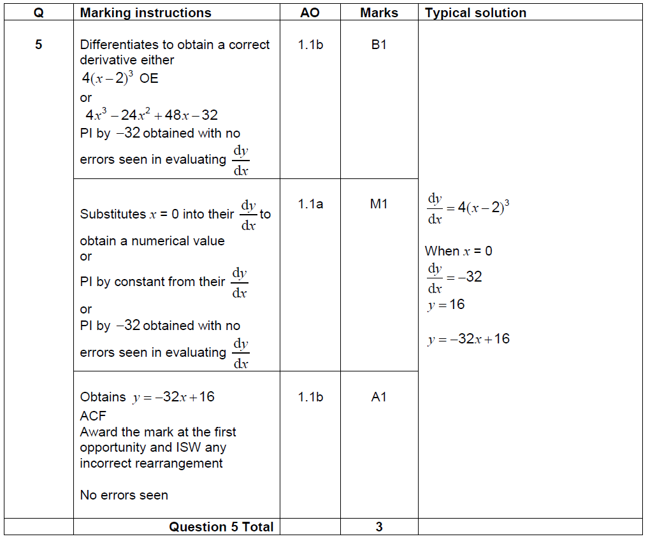
Question 5
The examiner says | Question
 | Mark scheme

Slide 7
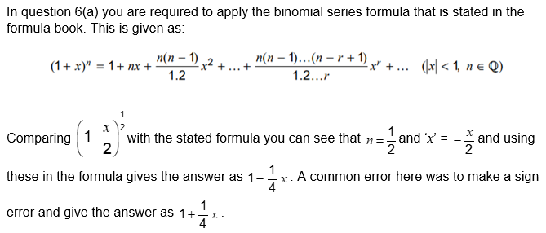
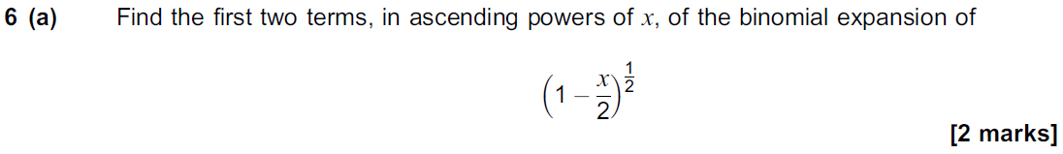
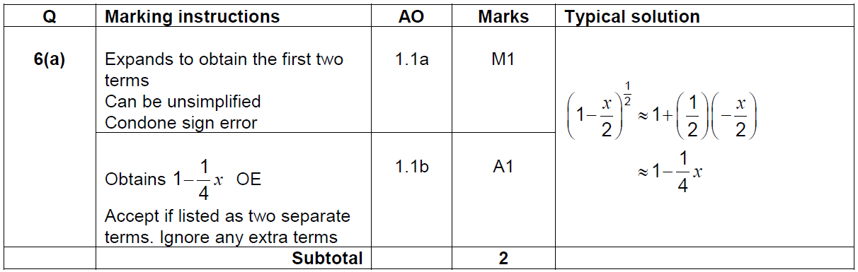
Question 6(a)
The examiner says | Question
 | Mark scheme

Slide 8
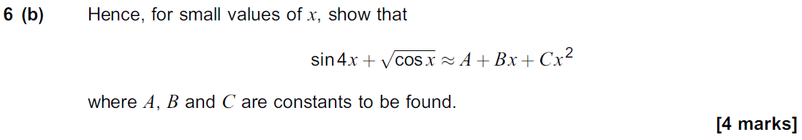
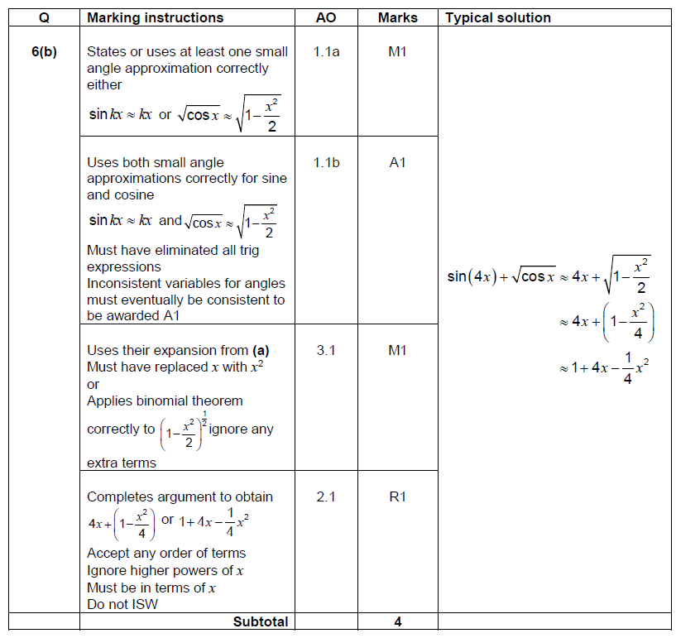
Question 6(b)
Question | Mark scheme

Slide 9
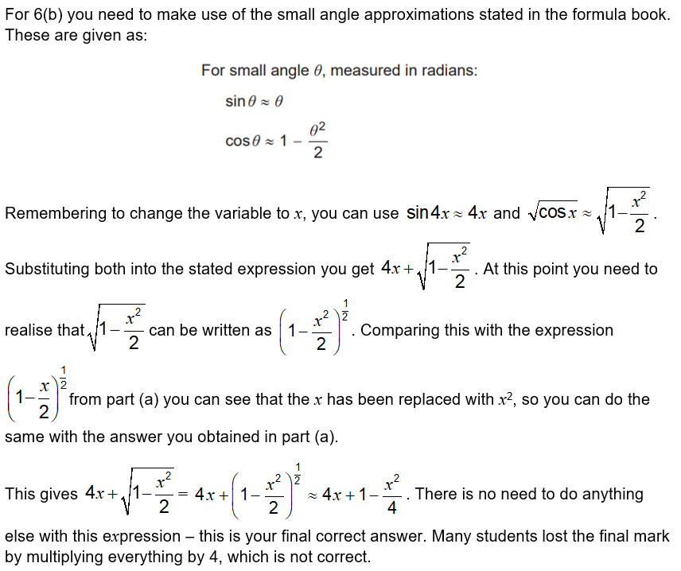
Question 6(b)
The examiner says

Slide 10
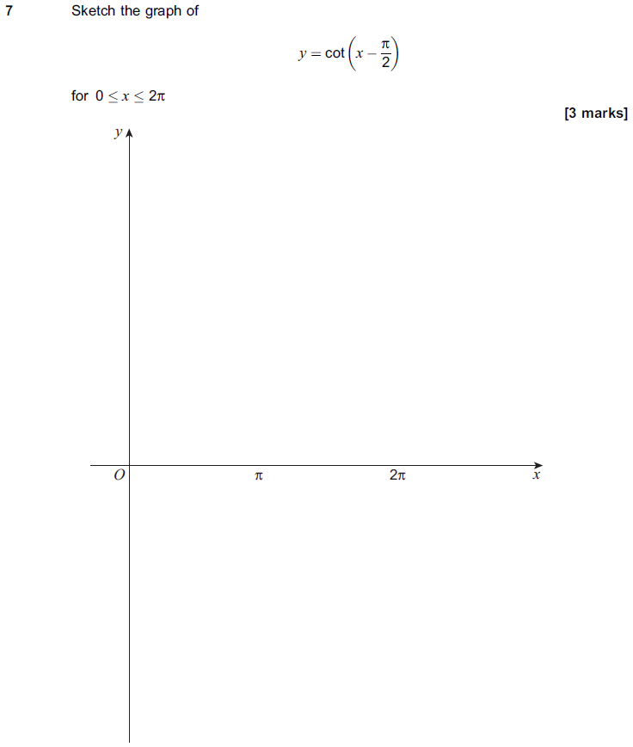
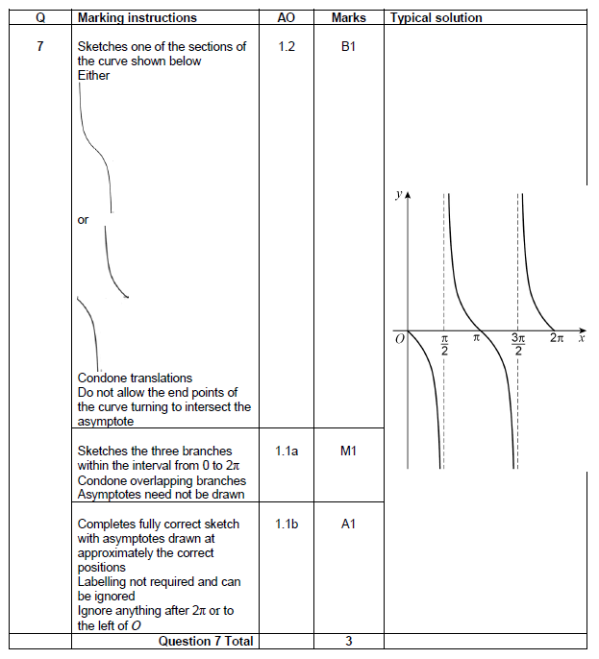
Question 7
Question | Mark scheme

Slide 11
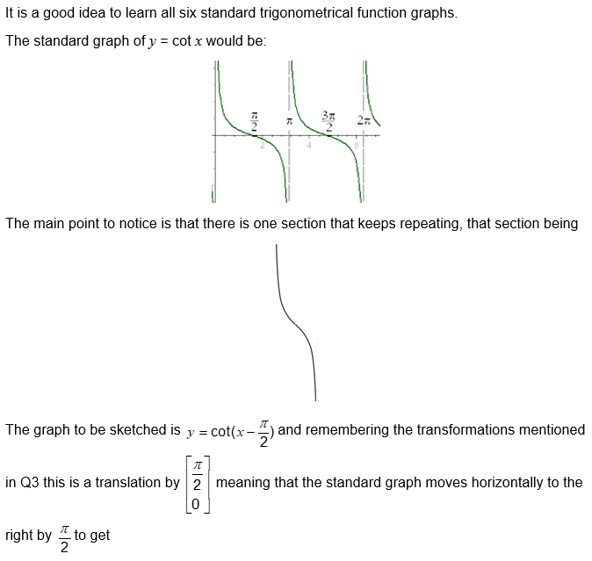
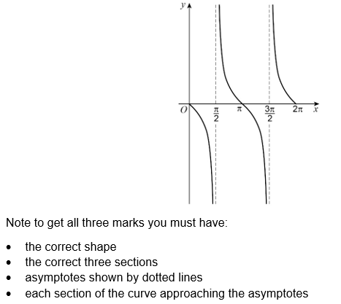
Question 7
The examiner says

Slide 12
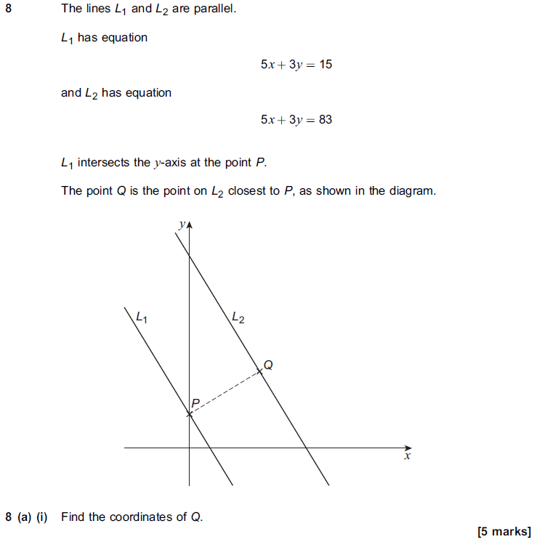
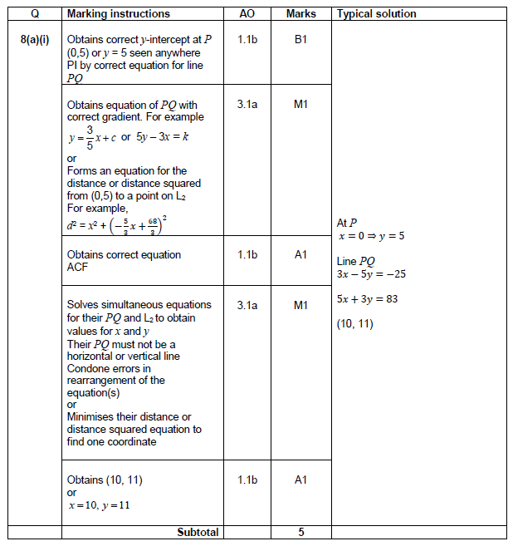
Question 8 (a)(i)
Question | Mark scheme

Slide 13
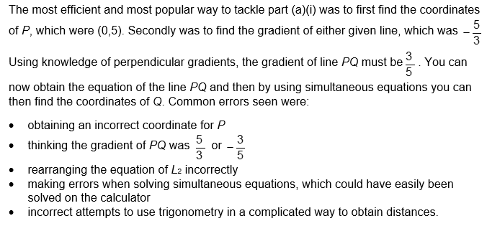
Question 8(a)(i)
The examiner says

Slide 14
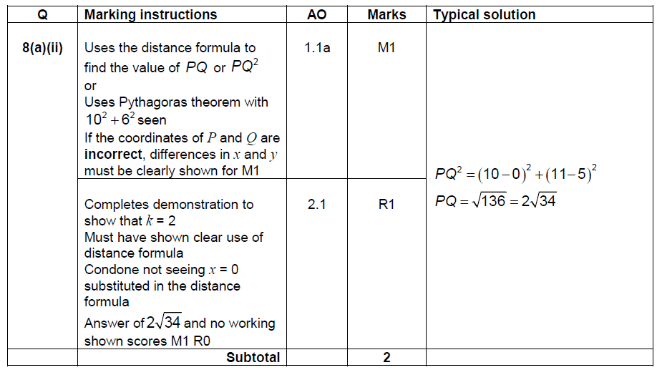

Question 8(a)(ii)
Question | Mark scheme
The examiner says

Slide 15
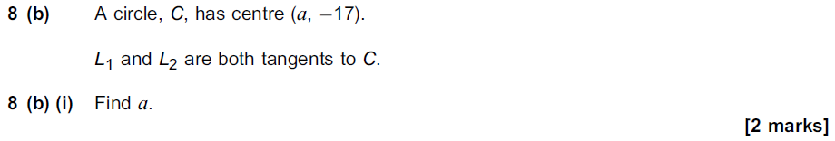
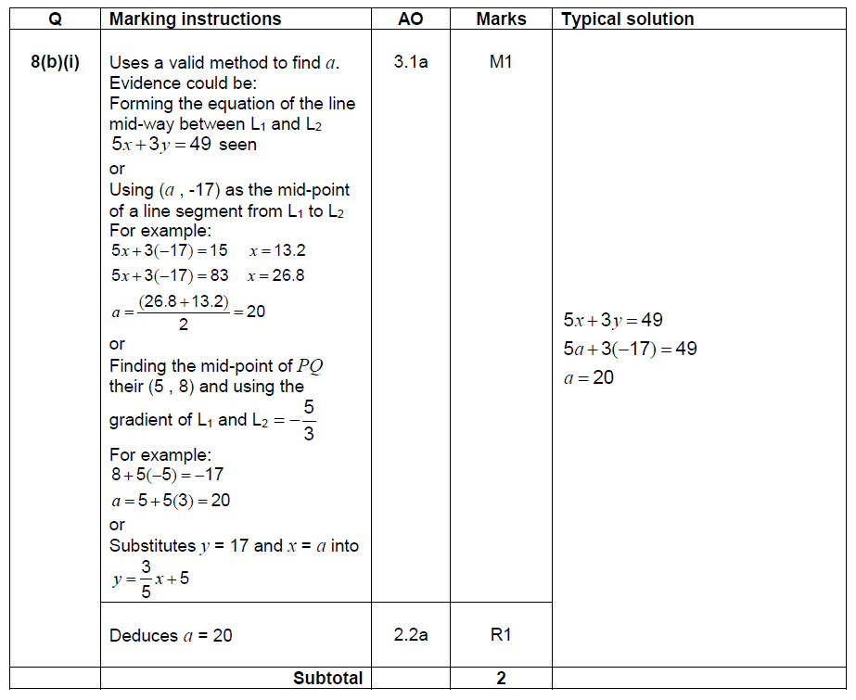
Question 8 (b)(i)
Question | Mark scheme

Slide 16
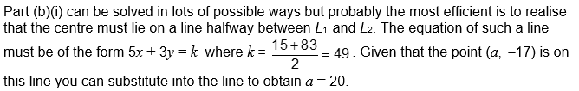
Question 8(b)(i)
The examiner says

Slide 17
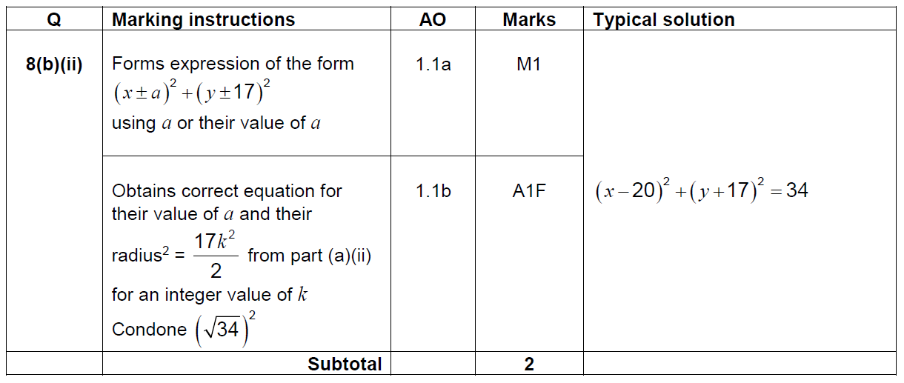
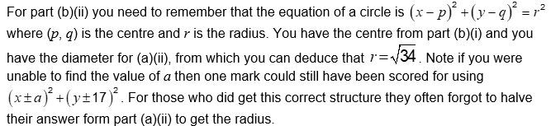
Question 8(b)(ii)
Question | Mark scheme
The examiner says

Slide 18
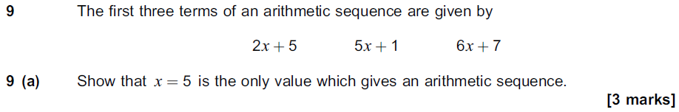
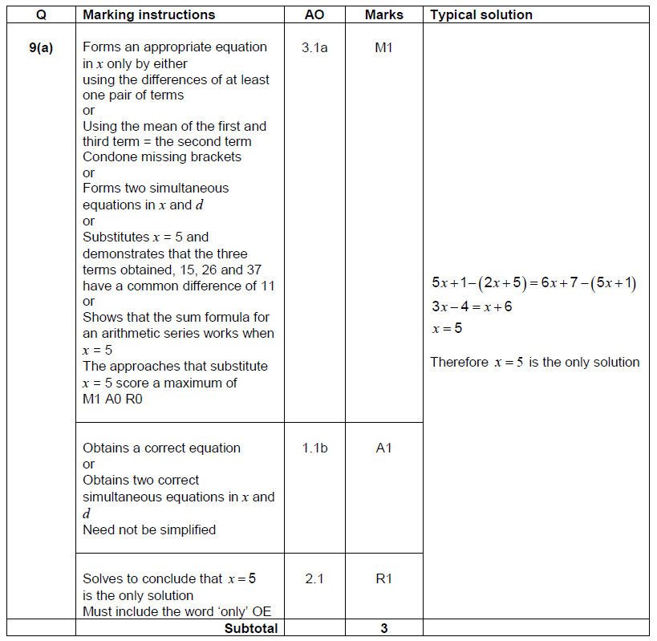
Question 9(a)
Question | Mark scheme

Slide 19
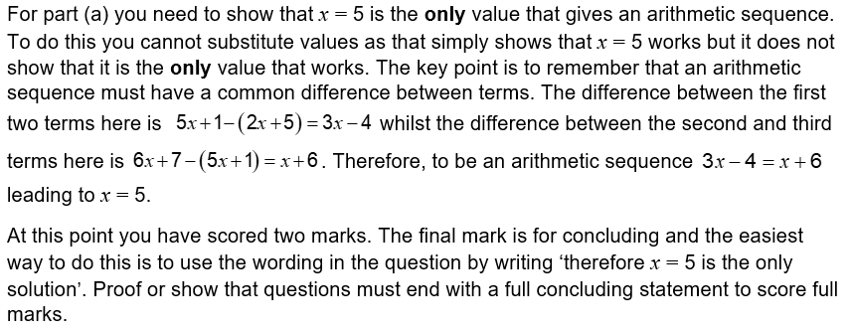
Question 9(a)
The examiner says

Slide 20
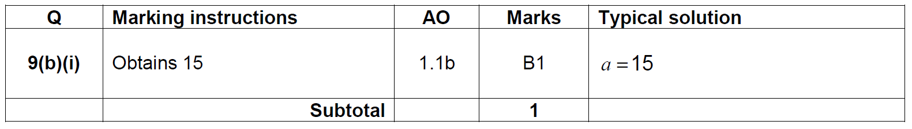

Question 9(b)(i)
Question | Mark scheme
The examiner says

Slide 21
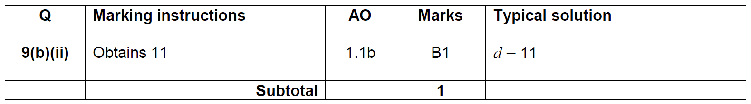
Question 9(b)(ii)
Question | Mark scheme
The examiner says

Slide 22
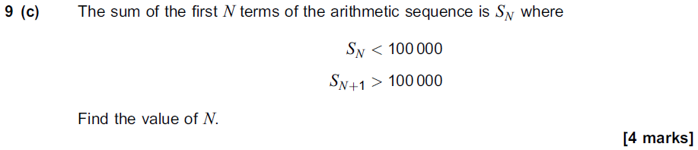
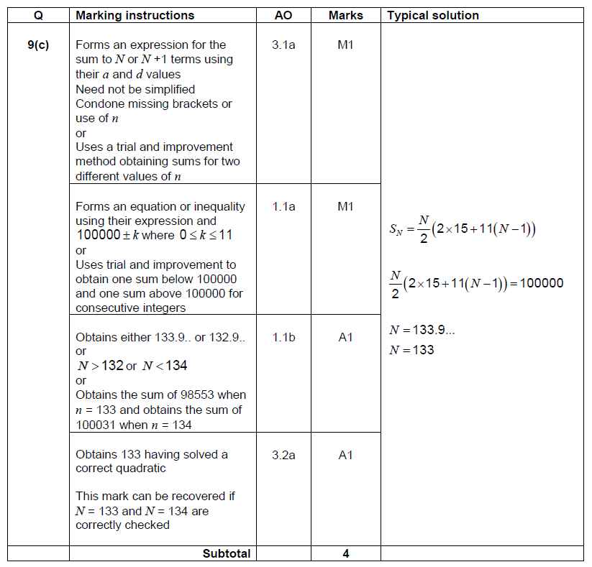
Question 9 (c)
Question | Mark scheme

Slide 23
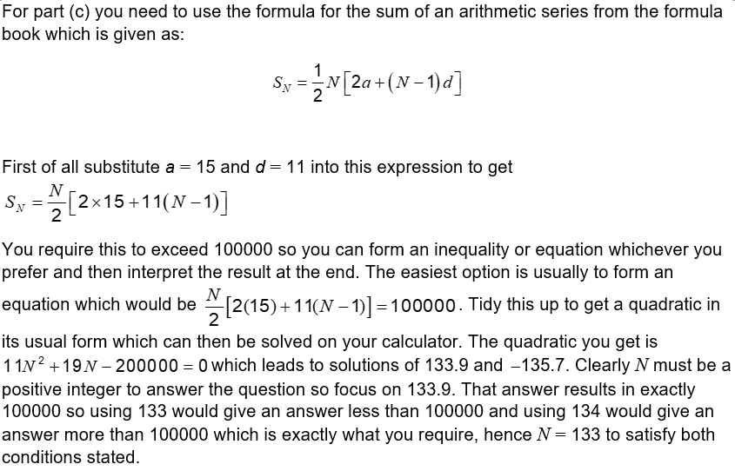
Question 9(c)
The examiner says

Slide 24
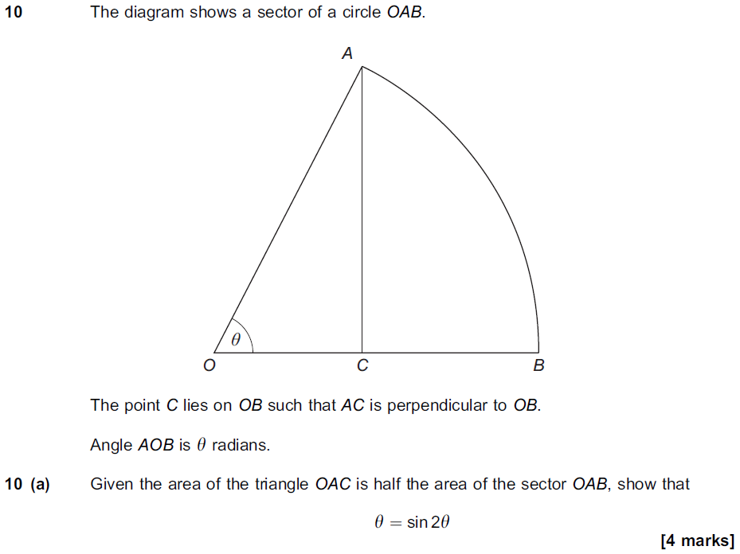
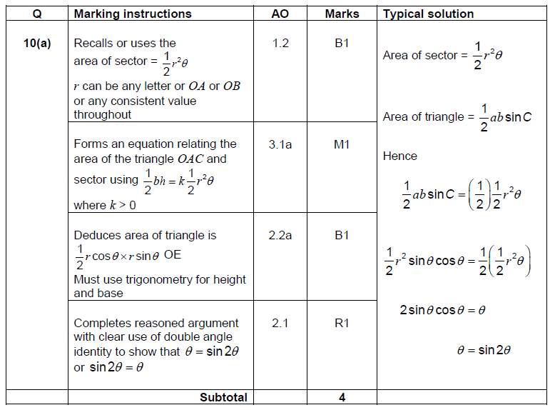
Question 10 (a)
Question | Mark scheme

Slide 25
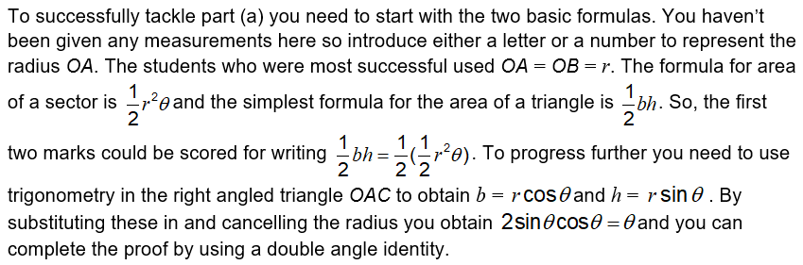
Question 10(a)
The examiner says

Slide 26
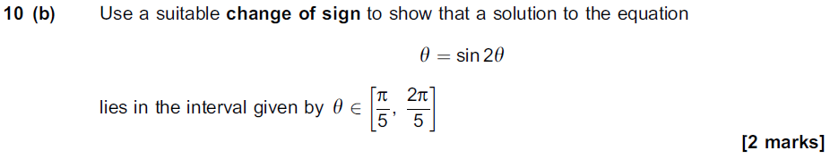
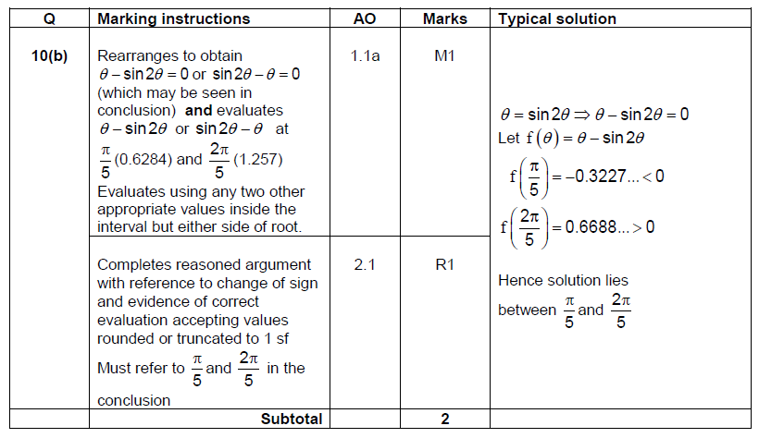
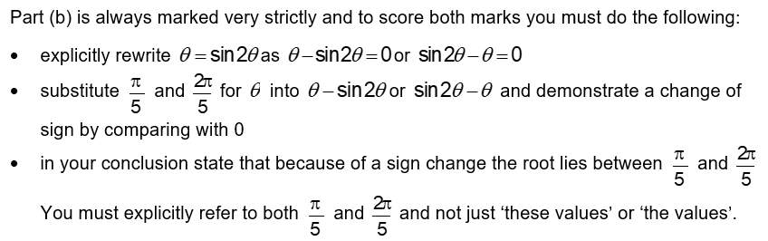
Question 10(b)
Question | Mark scheme
The examiner says

Slide 27



Question 10(c)(i)
Question | Mark scheme
The examiner says

Slide 28

Question 10(c)(ii)
Question | Mark scheme
The examiner says

Slide 29



Question 10(c)(iii)
Question | Mark scheme
The examiner says

Slide 30



Question 11(a)
Question | Mark scheme
The examiner says

Slide 31


Question 11(b)(i)
Question | Mark scheme

Slide 32

Question 11(b)(i)
The examiner says

Slide 33


Question 11(b)(ii)
Question | Mark scheme

Slide 34

Question 11(b)(ii)
The examiner says

Slide 35



Question 12(a)(i)
Question | Mark scheme
The examiner says

Slide 36



Question 12(a)(ii)
Question | Mark scheme
The examiner says

Slide 37



Question 12(b)
The examiner says | Question
 | Mark scheme

Slide 38



Question 13 (a)
Question | Mark scheme
 | The examiner says

Slide 39

Question 13 (b)
Question | Mark scheme

Slide 40

Question 13 (b)
The examiner says

Slide 41

Question 13(c)
Question | Mark scheme
The examiner says

Slide 42


Question 14(a)
Question | Mark scheme

Slide 43

Question 14(a)
The examiner says

Slide 44


Question 14 (b)
Question | Mark scheme

Slide 45

Question 14(b)
The examiner says

Slide 46



Question 15(a)(i)
Question | Mark scheme
The examiner says

Slide 47


Question 15(a)(ii)
Question | Mark scheme

Slide 48

Question 15(a)(ii)
The examiner says

Slide 49


Question 15 (a) (iii)
Question | Mark scheme

Slide 50

Question 15(a)(iii)
The examiner says

Slide 51


Question 15(b)(i)
Question | Mark scheme

Slide 52

Question 15(b)(i)
The examiner says

Slide 53


Question 15(b)(ii)
Question | Mark scheme

Slide 54

Question 15(b)(ii)
The examiner says

