Slide 1

A-Level Maths
Mock exam analyser
7357/2
June 2022

Slide 2
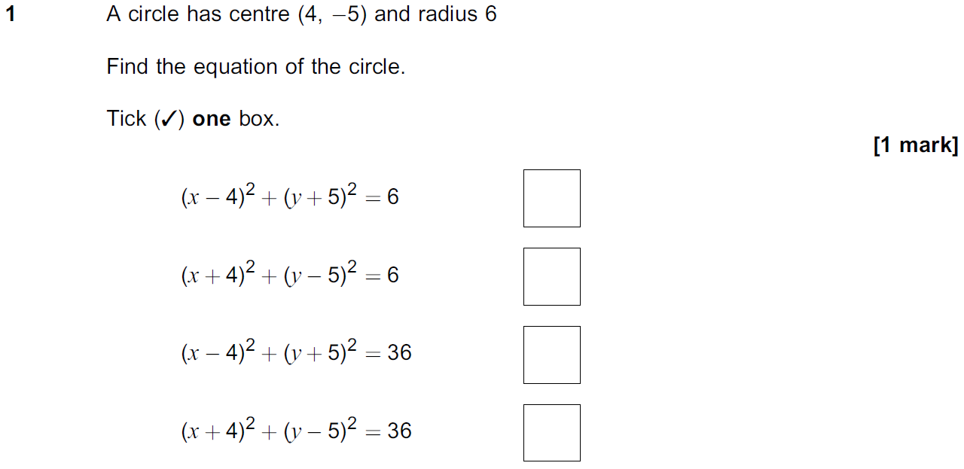
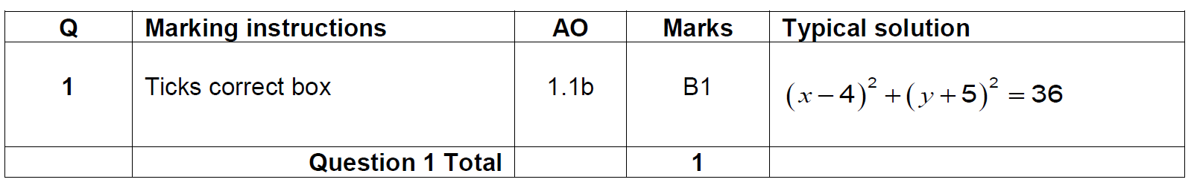
Question 1
Question | Mark scheme
The examiner says

Slide 3
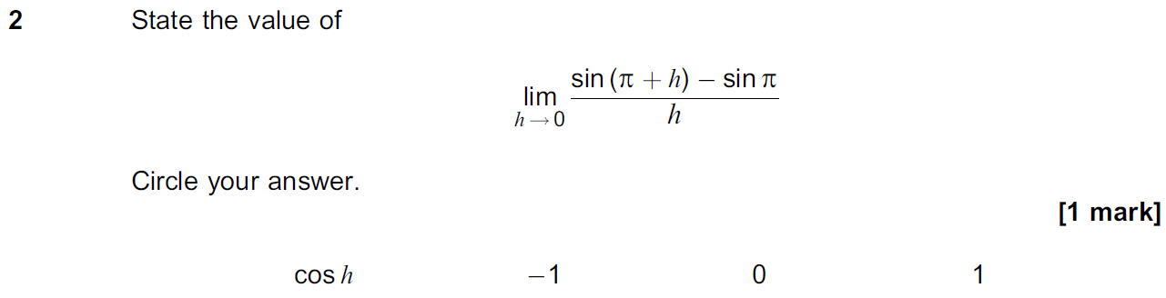
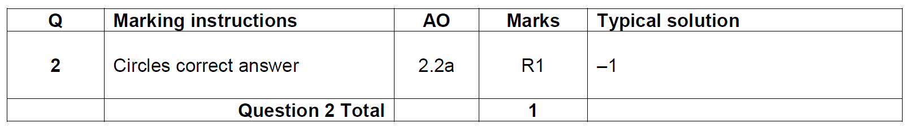
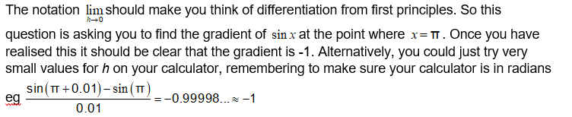
Question 2
Question | Mark scheme
The examiner says

Slide 4
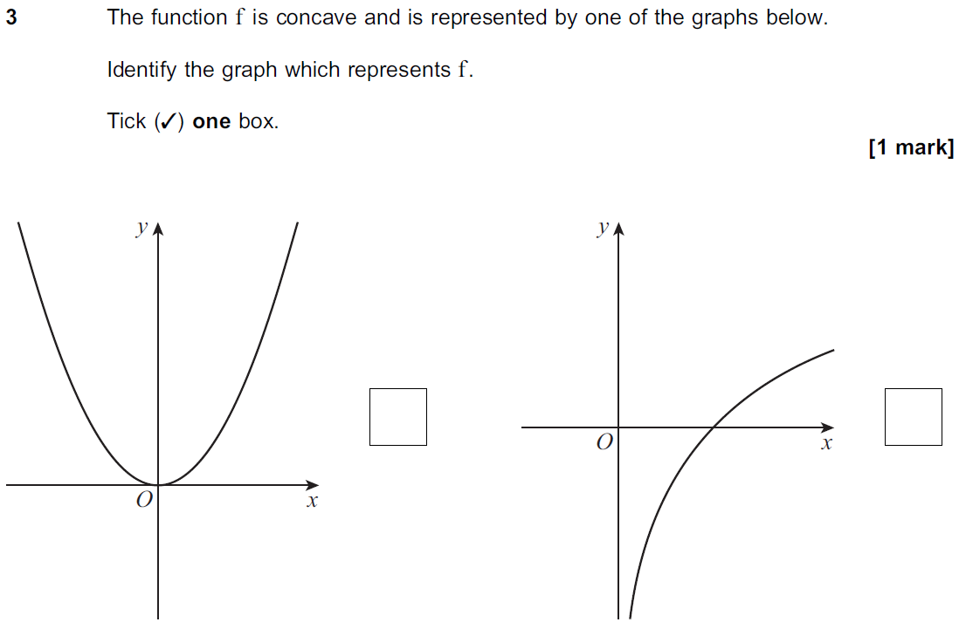
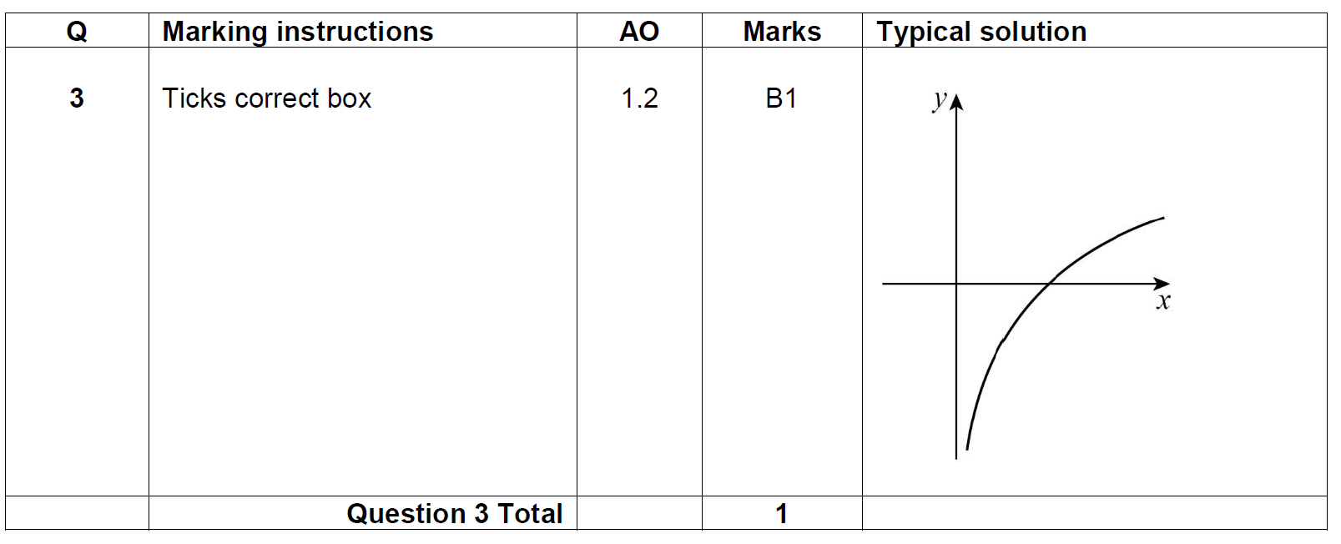
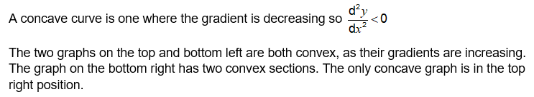
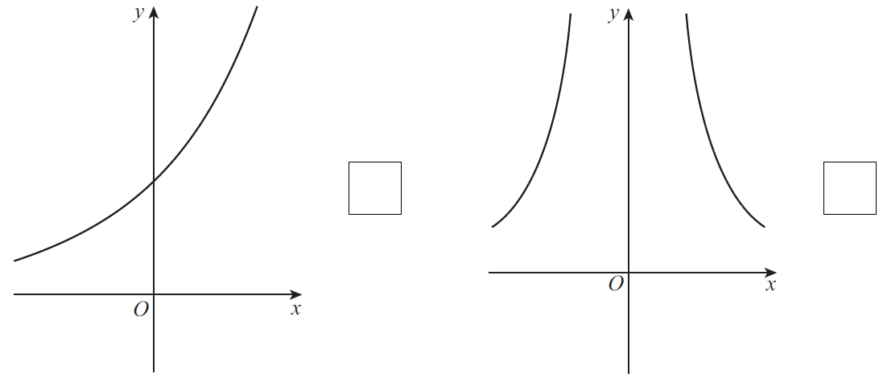
Question 3
Question | Mark scheme
 | The examiner says

Slide 5
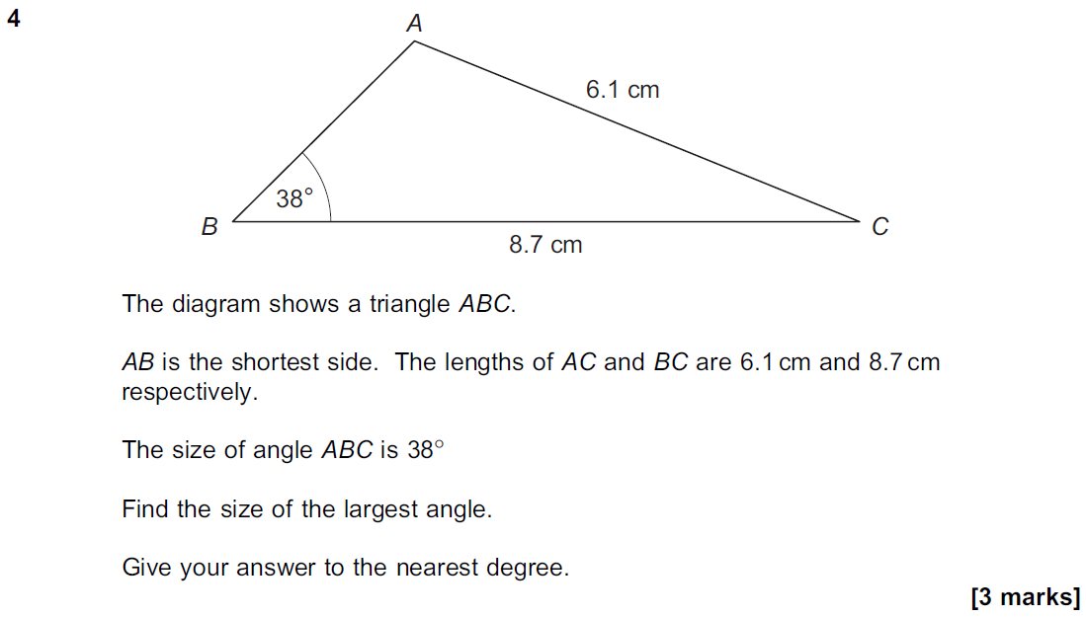
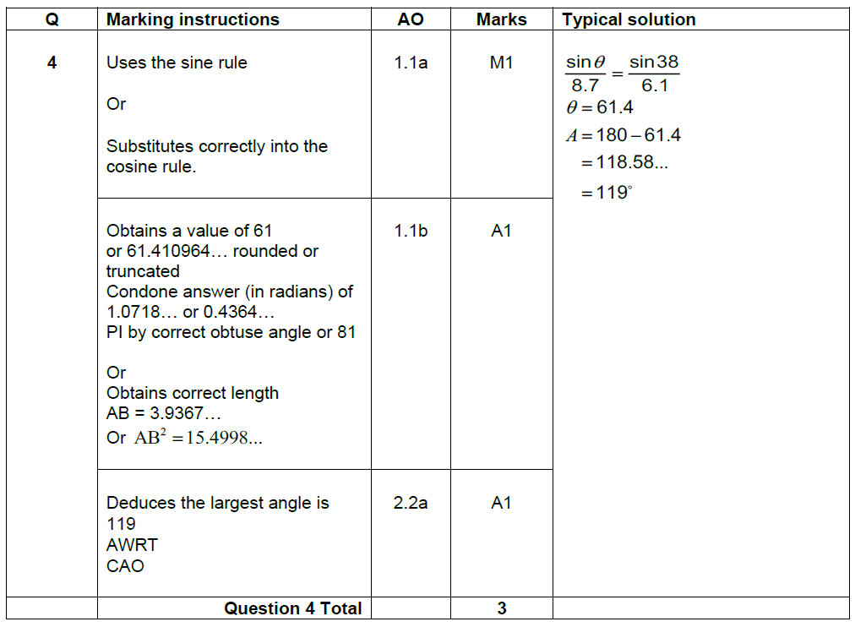
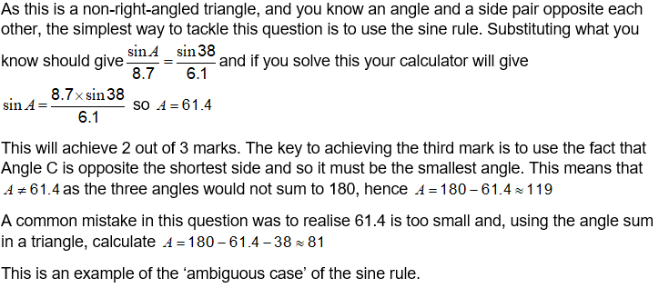
Question 4
Question | Mark scheme
The examiner says

Slide 6
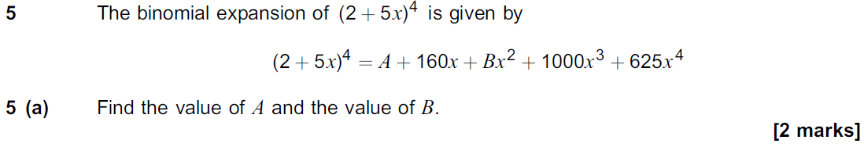
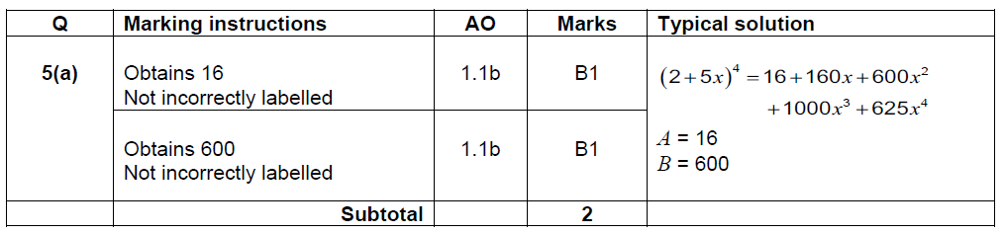

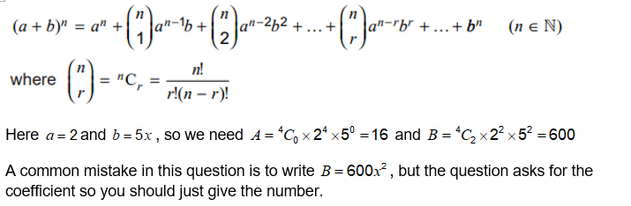
Question 5(a)
Question | Mark scheme
The examiner says

Slide 7
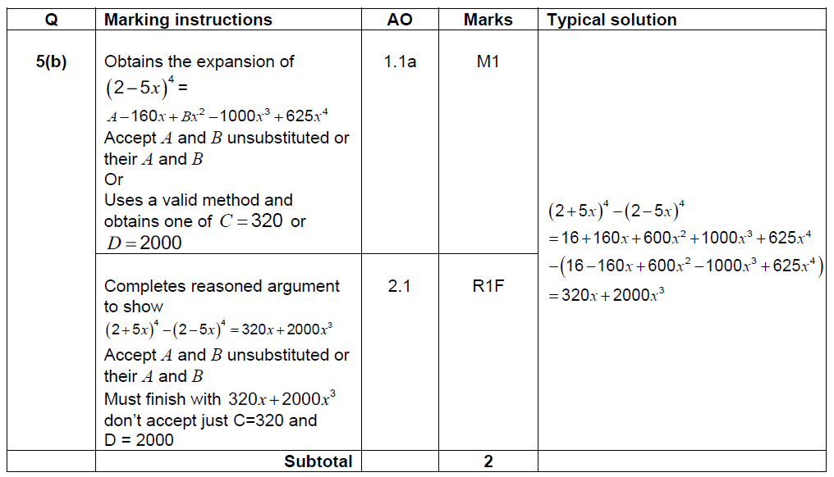
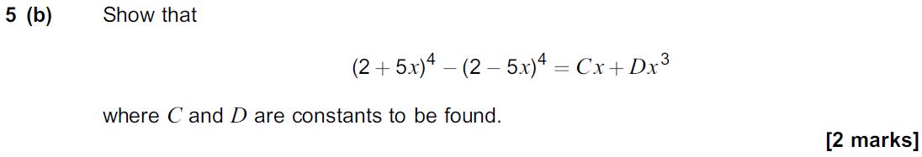
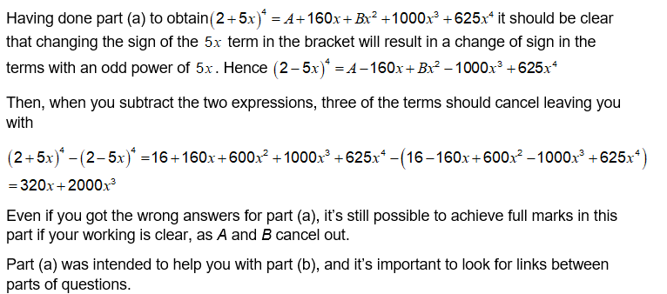
Question 5(b)
Question | Mark scheme
The examiner says

Slide 8
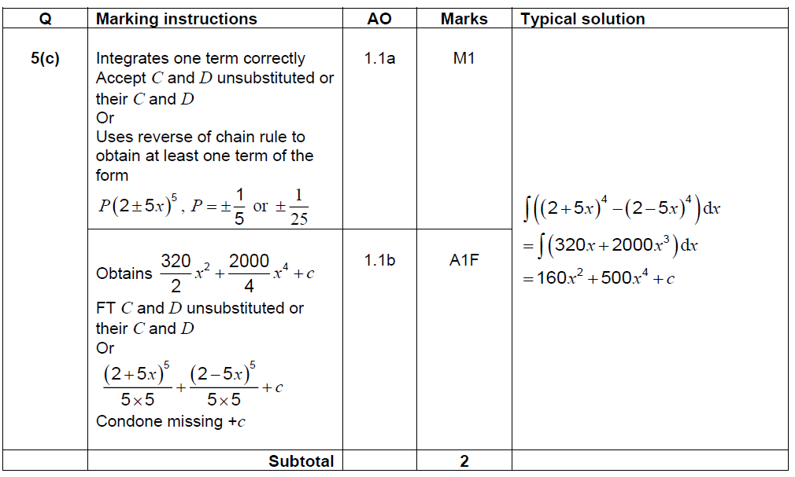
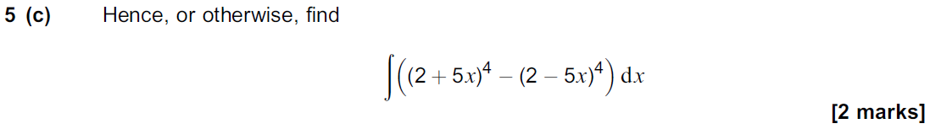
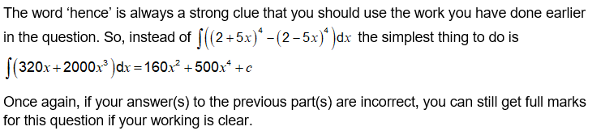
Question 5(c)
Question | Mark scheme
The examiner says

Slide 9
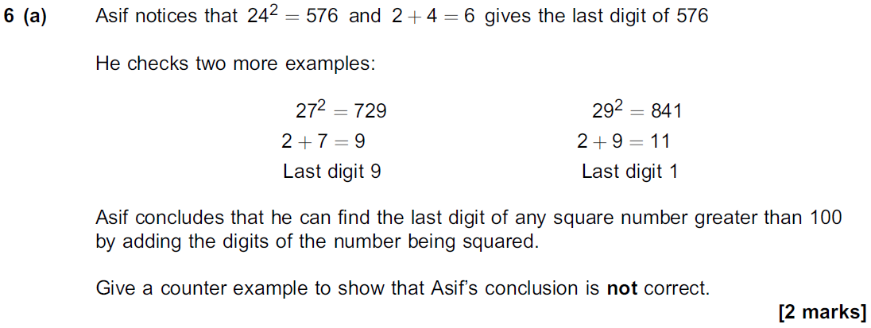
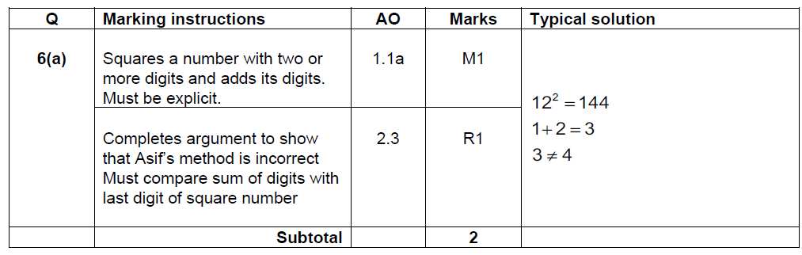
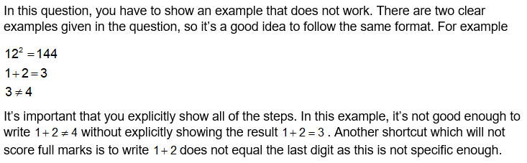
Question 6(a)
Question | Mark scheme
The examiner says

Slide 10
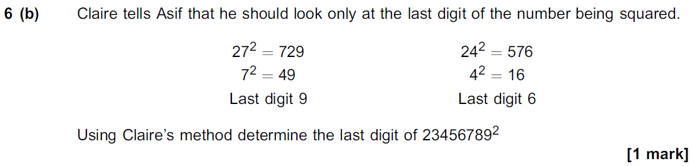
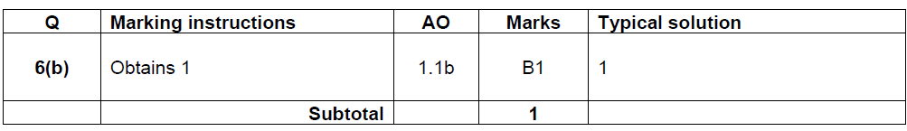

Question 6(b)
Question | Mark scheme
The examiner says

Slide 11
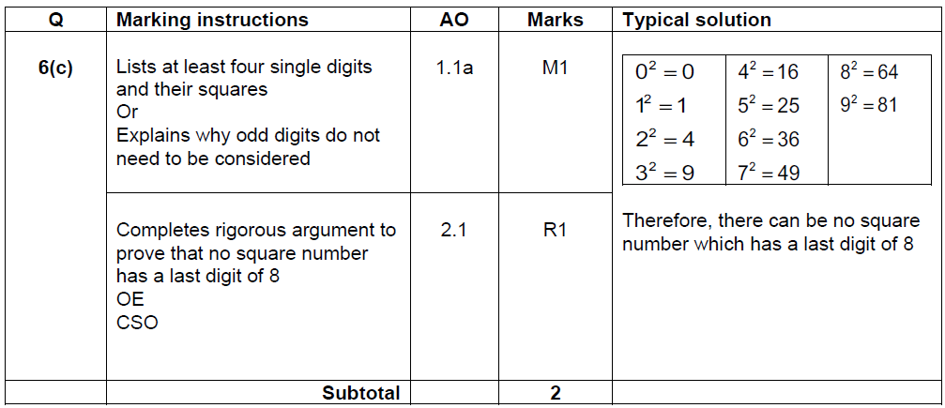
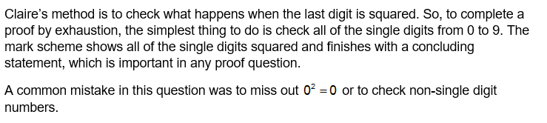
Question 6(c)
Question | Mark scheme
The examiner says

Slide 12
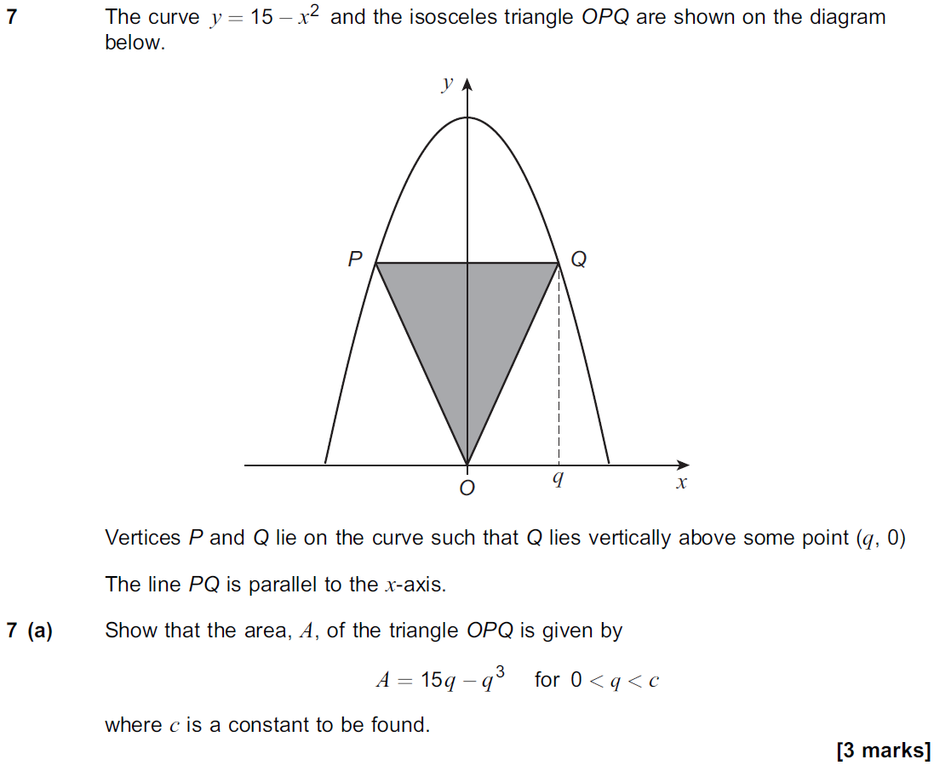
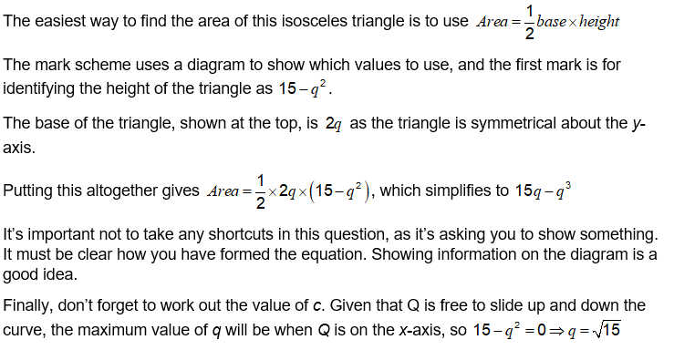
Question 7(a)
Question | The examiner says

Slide 13
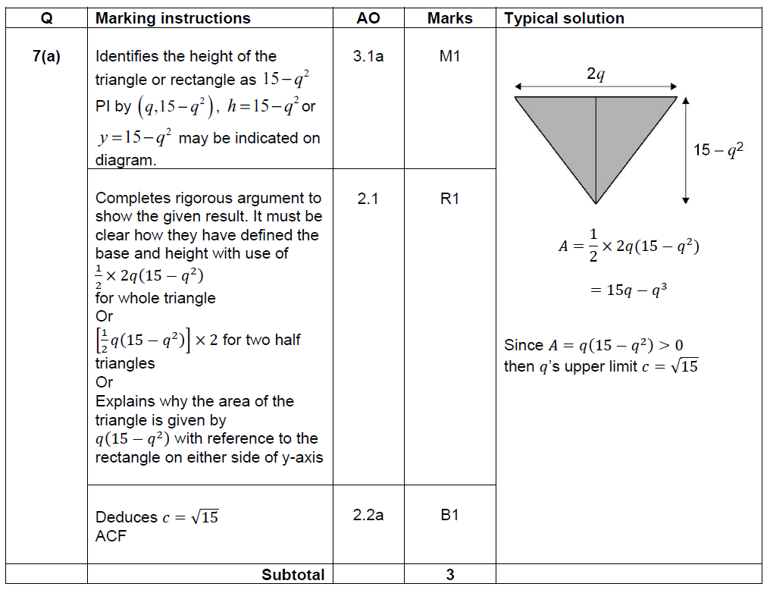
Question 7(a)
Mark scheme

Slide 14
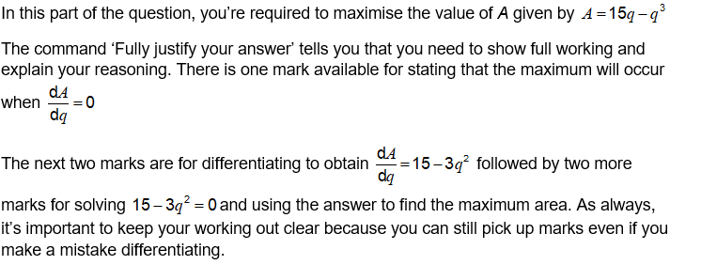
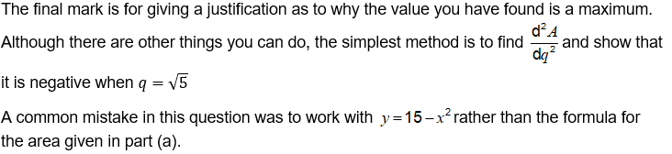
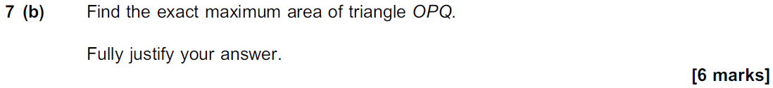
Question 7(b)
Question | The examiner says

Slide 15
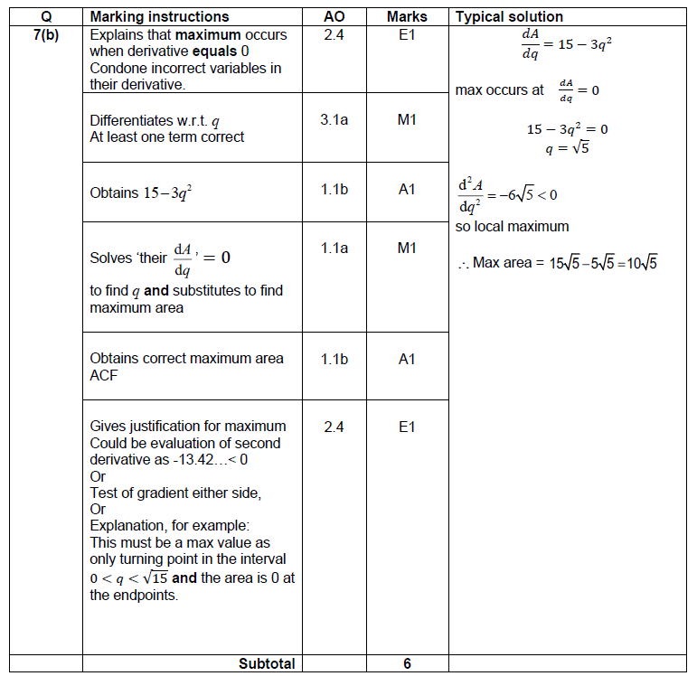
Question 7(b)
Mark scheme

Slide 16
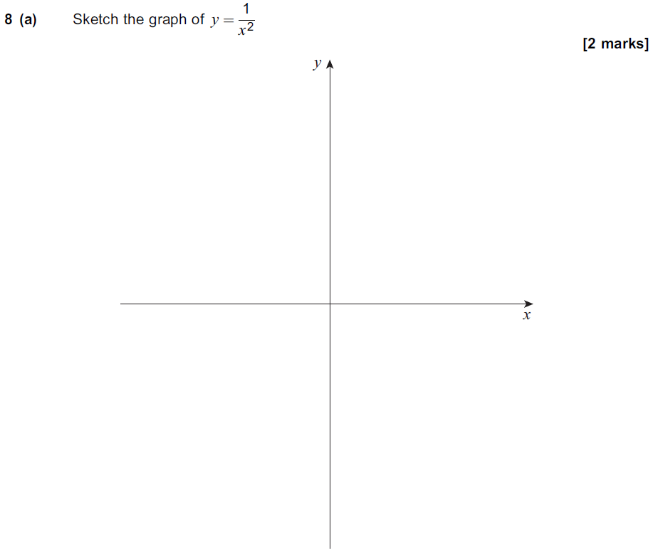
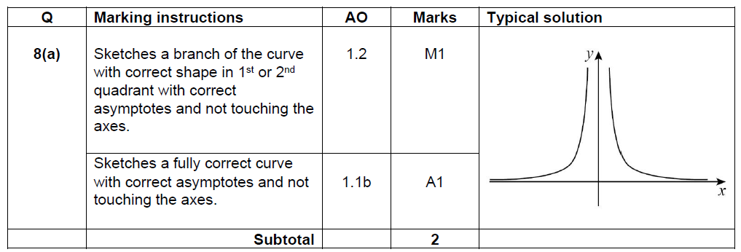
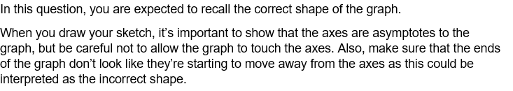
Question 8(a)
Question | Mark scheme
 | The examiner says

Slide 17
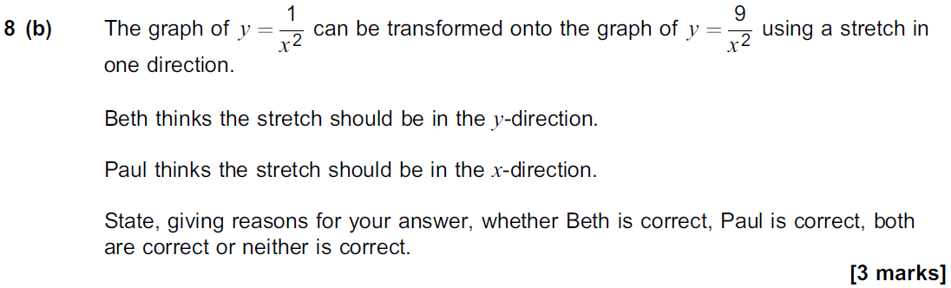
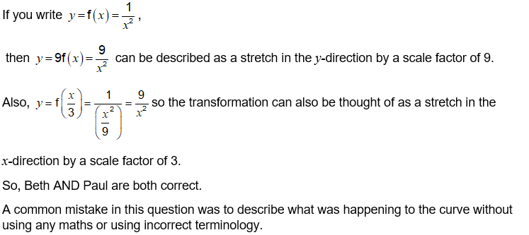
Question 8(b)
Question | The examiner says

Slide 18
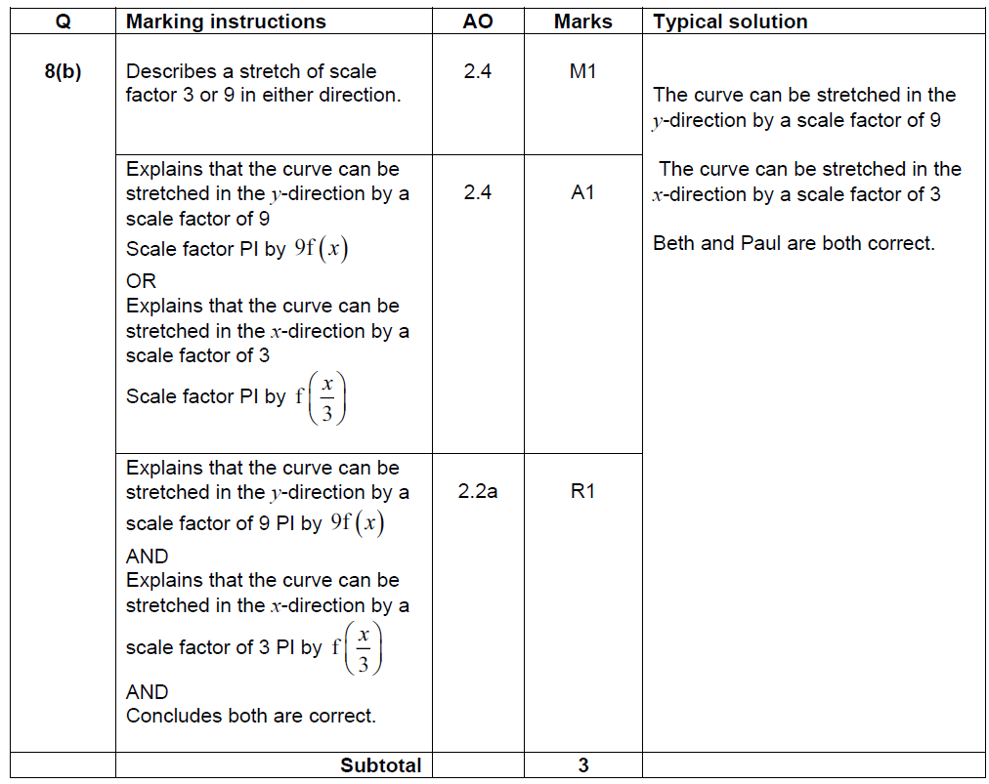
Question 8(b)
Mark scheme

Slide 19
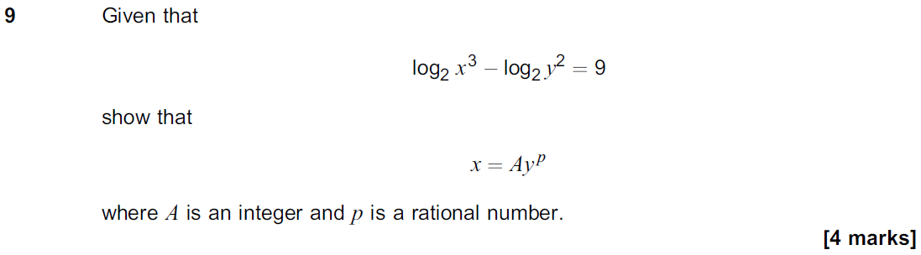
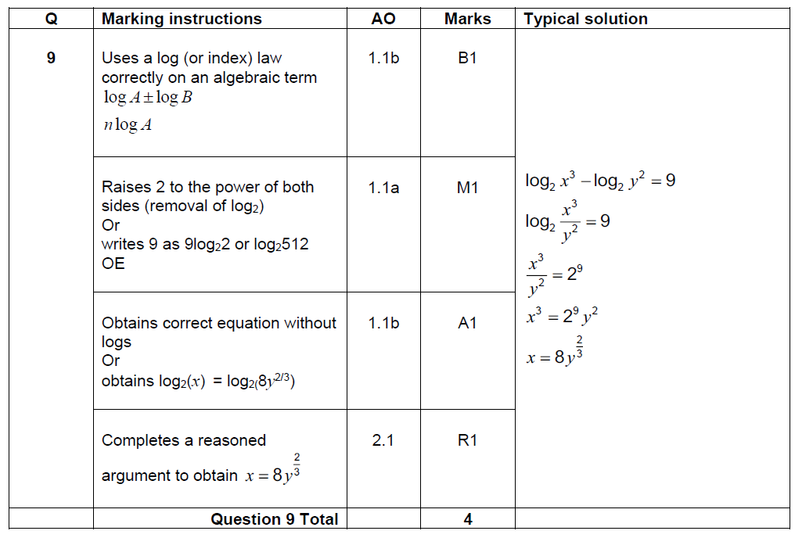
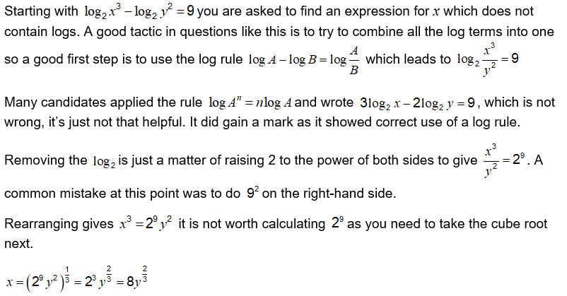
Question 9
Question | Mark scheme
The examiner says

Slide 20
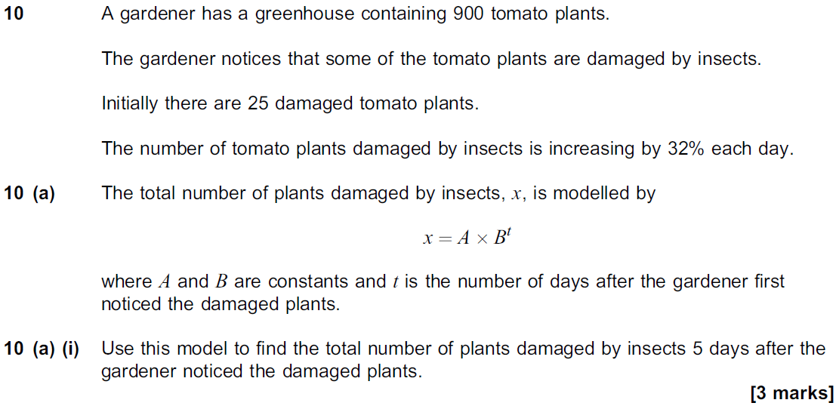
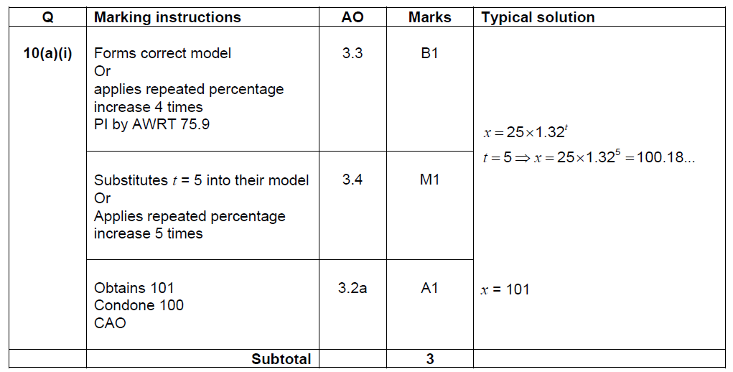
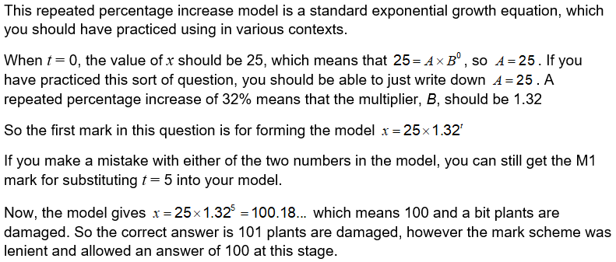
Question 10(a)(i)
Question | Mark scheme
The examiner says

Slide 21
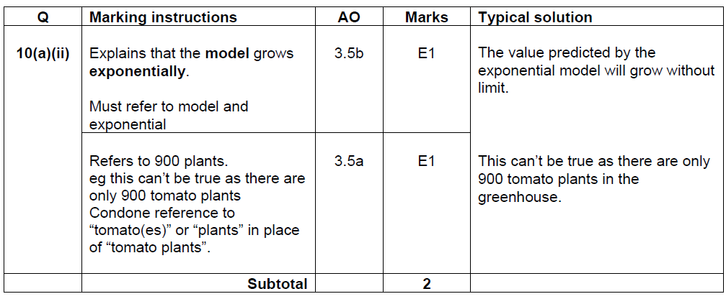
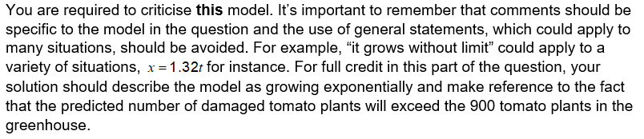
Question 10(a)(ii)
Question | Mark scheme
The examiner says

Slide 22
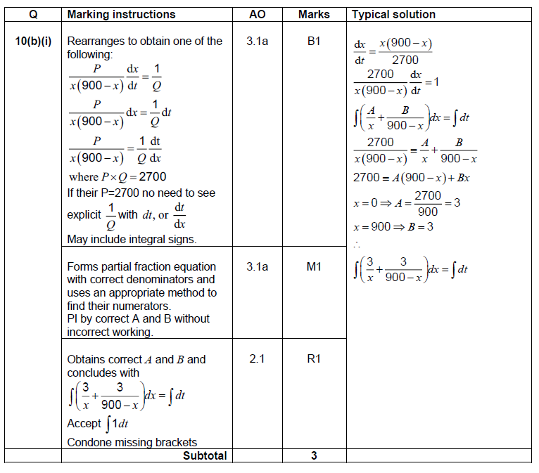


Question 10(b)(i)
Mark scheme | Question
 | The examiner says

Slide 23


Question 10(b)(ii)
Mark scheme | Question
 | The examiner says

Slide 24


Question 10(b)(iii)
Question | Mark scheme
The examiner says

Slide 25



Question 11
Question | Mark scheme
The examiner says

Slide 26



Question 12
Question | Mark scheme
The examiner says

Slide 27



Question 13(a)
Question | Mark scheme
The examiner says

Slide 28


Question 13(b)
Question | Mark scheme
The examiner says

Slide 29



Question 13(c)
Question | Mark scheme
The examiner says

Slide 30



Question 14(a)
Question | Mark scheme
The examiner says

Slide 31


Question 14(b)
Question | Mark scheme
The examiner says

Slide 32



Question 15
Question | Mark scheme
The examiner says

Slide 33


Question 16(a)
Question | Mark scheme

Slide 34

Question 16(a)
The examiner says

Slide 35


Question 16(b)(i)
Question | Mark scheme
The examiner says

Slide 36


Question 16(b)(ii)
Mark scheme | Question
 | The examiner says

Slide 37


Question 17
Question | Mark scheme

Slide 38

Question 17
The examiner says

Slide 39


Question 18(a)
Question | Mark scheme

Slide 40

Question 18(a)
The examiner says

Slide 41



Question 18(b)
Question | Mark scheme
The examiner says

Slide 42


Question 19 (a)
Question | Mark scheme

Slide 43

Question 19 (a)
The examiner says

Slide 44



Question 19 (b)(i)
Question | Mark scheme
 | The examiner says

Slide 45


Question 19 (b)(ii)
Question | Mark scheme
 | The examiner says

