Slide 1

A-Level Maths
Mock exam analyser
7357/3
June 2022

Slide 2
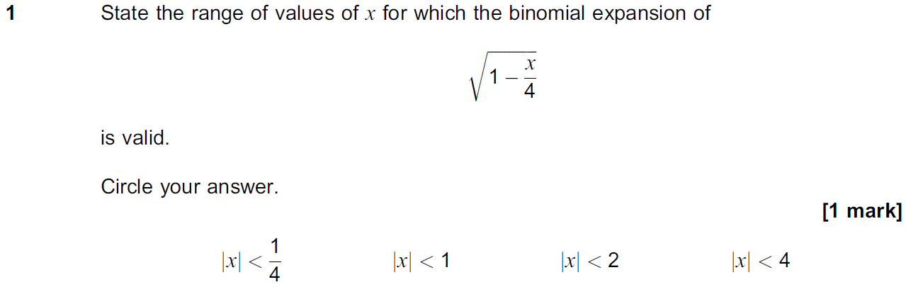
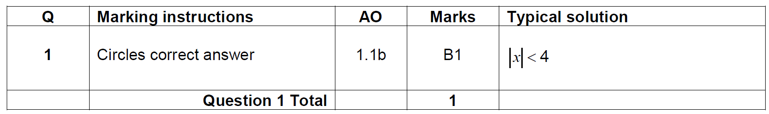
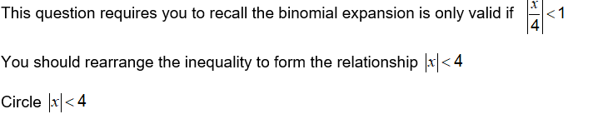
Question 1
Question | Mark scheme
The examiner says

Slide 3
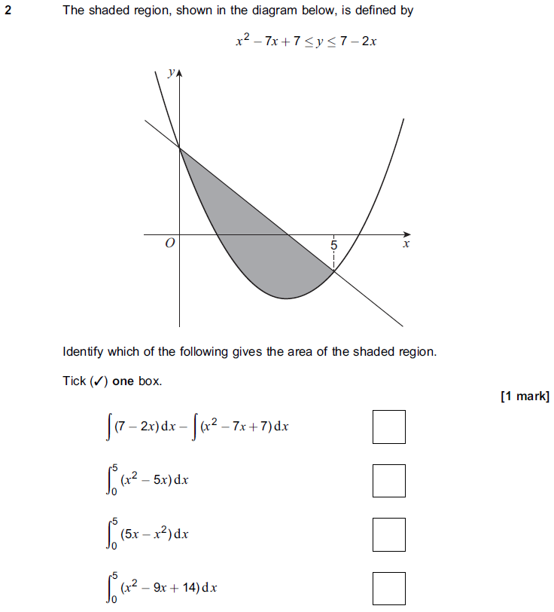
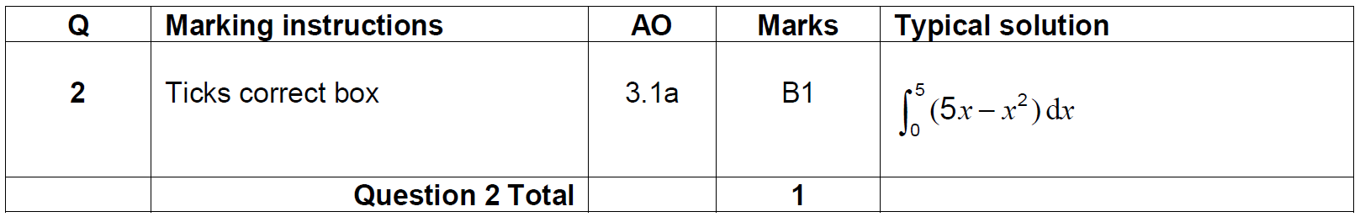
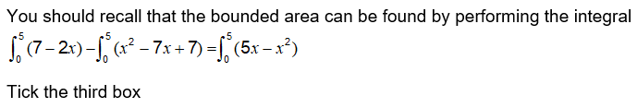
Question 2
Question | Mark scheme
 | The examiner says

Slide 4
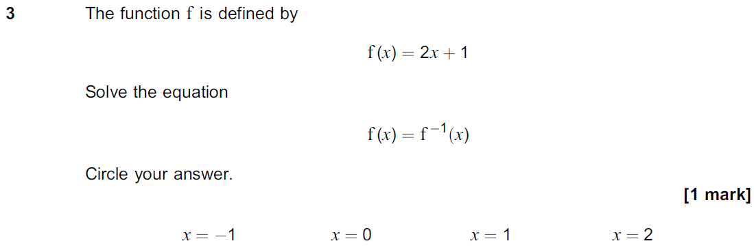
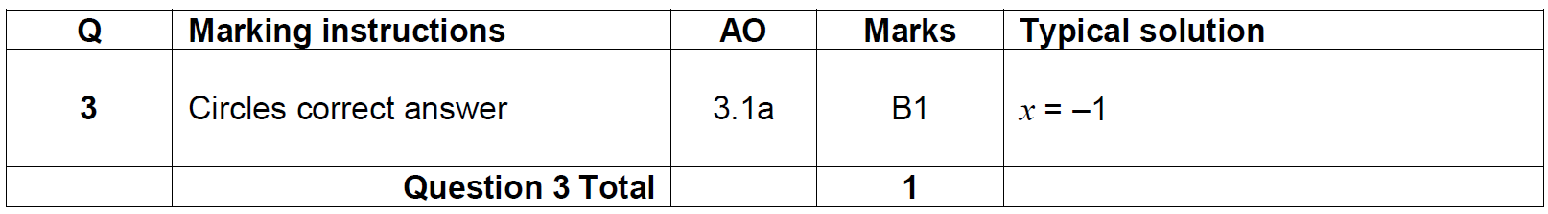
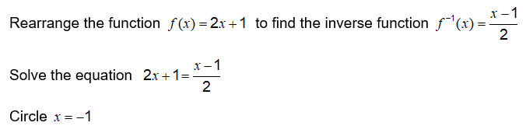
Question 3
Question | Mark scheme
The examiner says

Slide 5
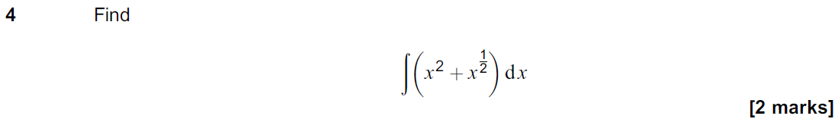
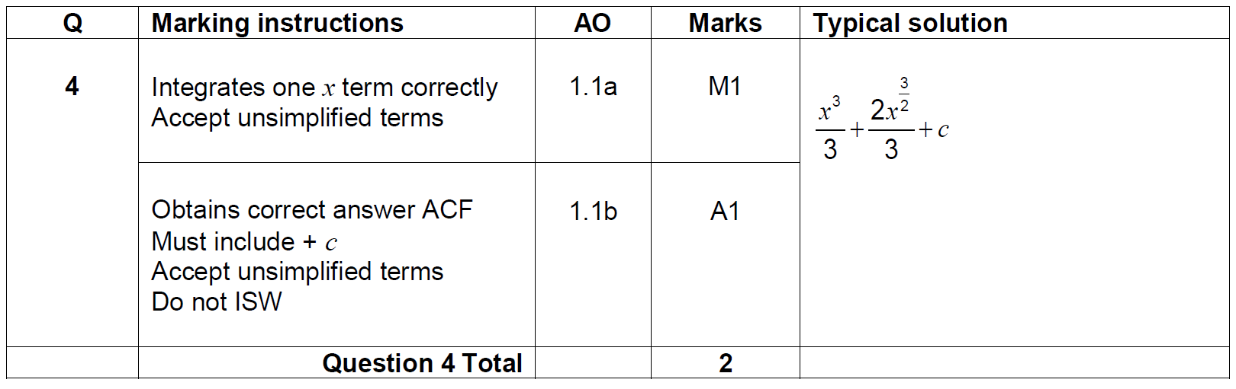
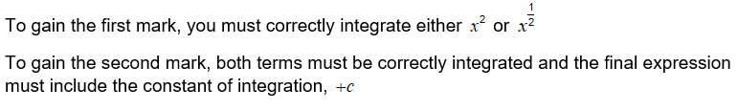
Question 4
Question | Mark scheme
The examiner says

Slide 6
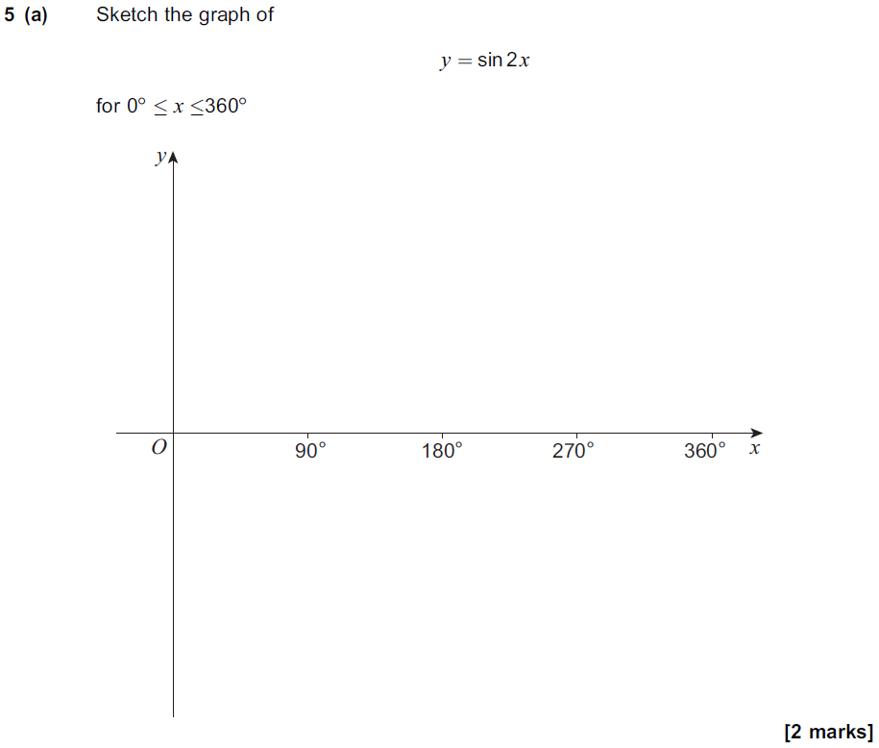
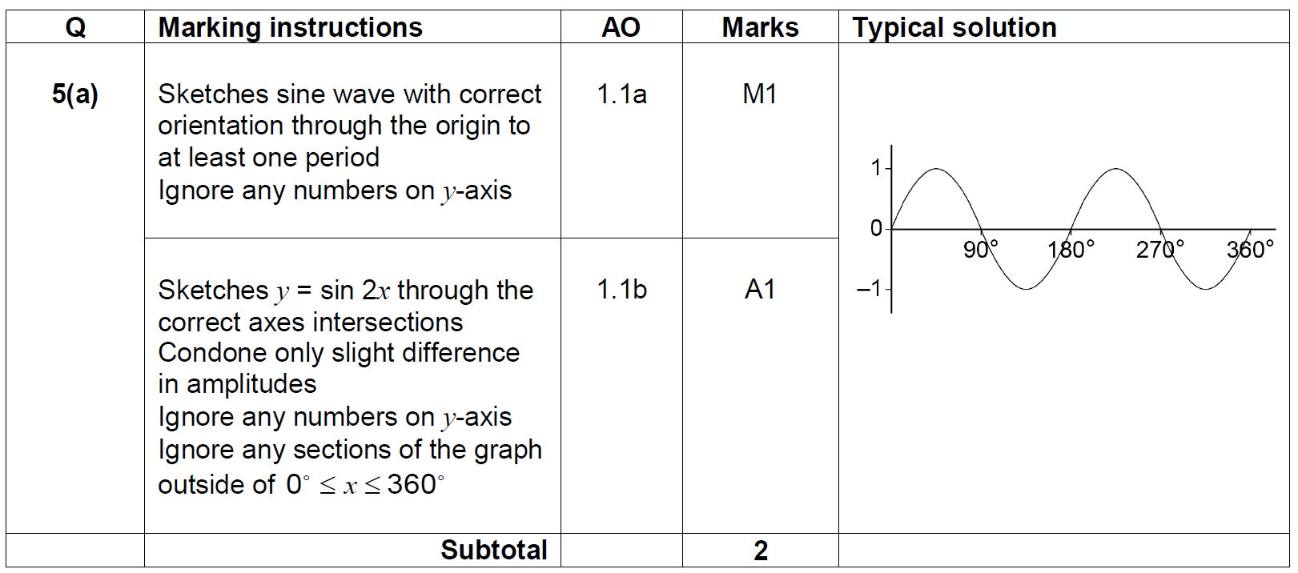
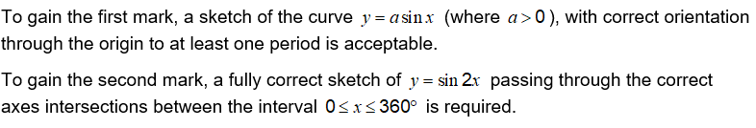
Question 5(a)
Question | Mark scheme
 | The examiner says

Slide 7
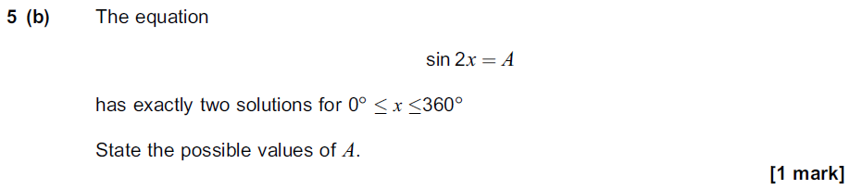
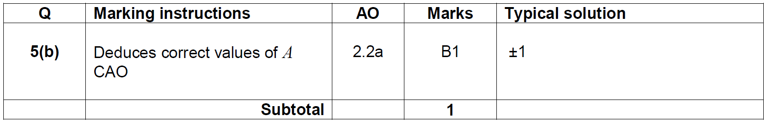
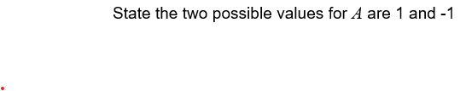
Question 5(b)
Question | Mark scheme
The examiner says

Slide 8
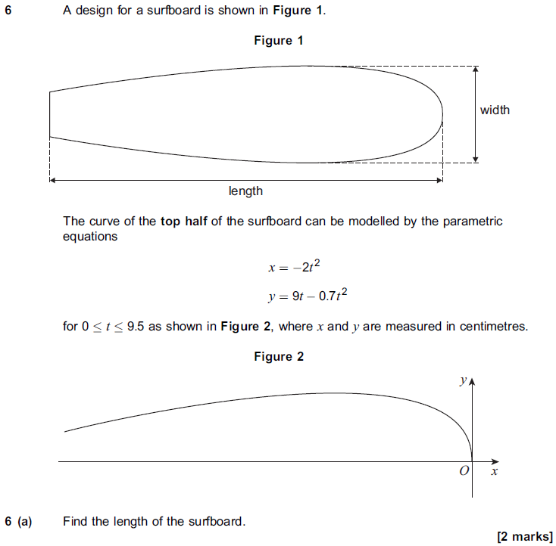
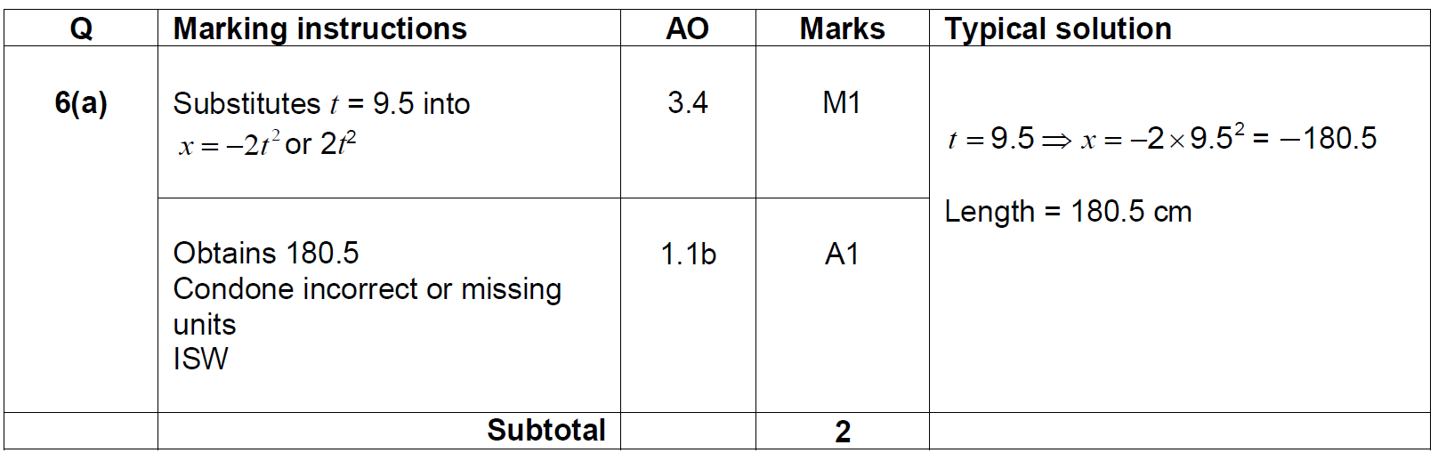
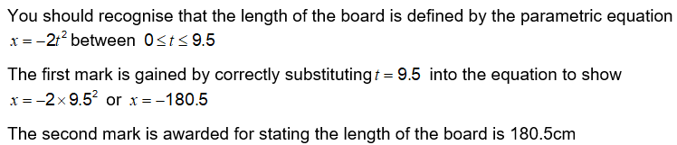
Question 6(a)
Question | Mark scheme
 | The examiner says

Slide 9
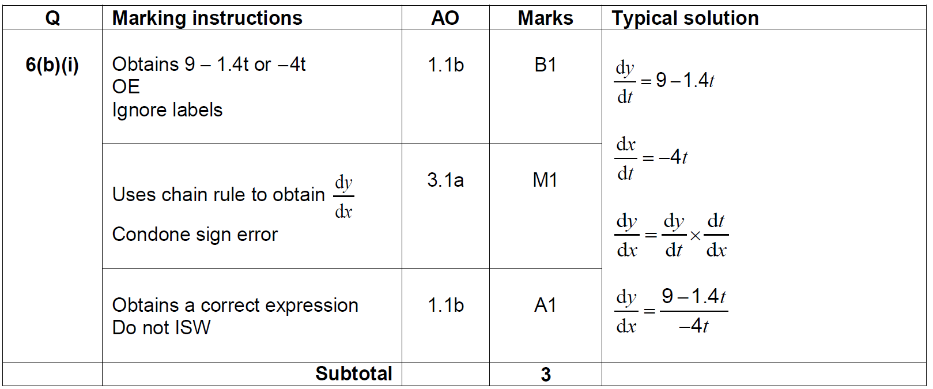
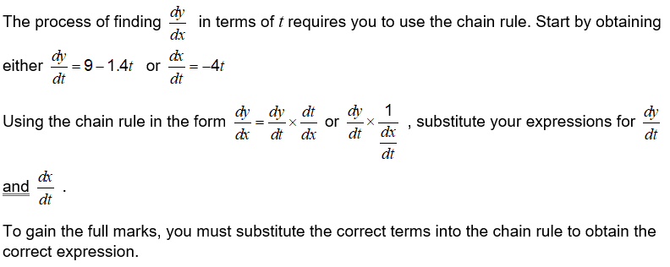
Question 6(b)(i)
Question | Mark scheme
 | The examiner says

Slide 10
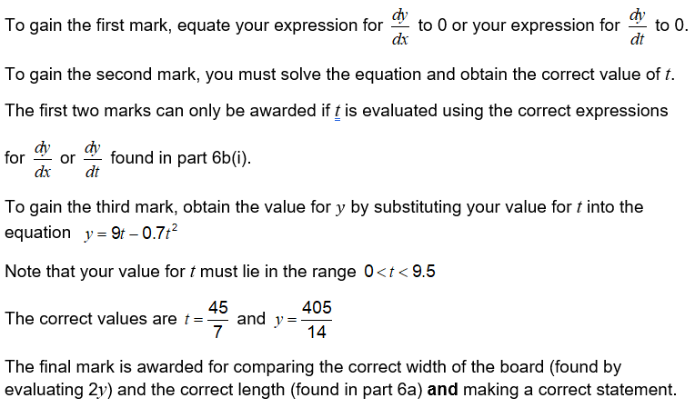
Question 6(b)(ii)
Question | The examiner says

Slide 11
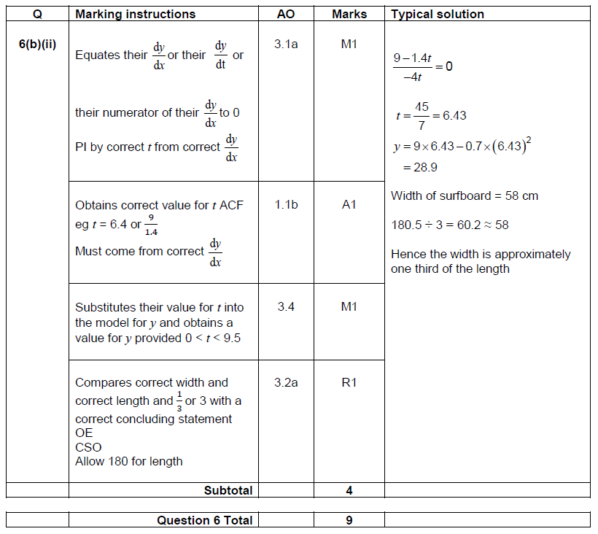
Question 6(b)(ii)
Mark scheme

Slide 12
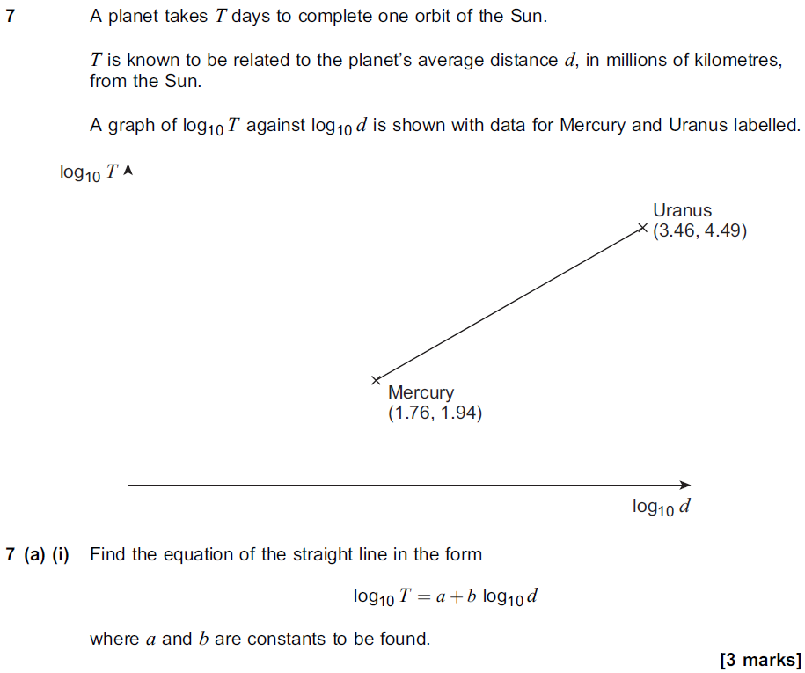
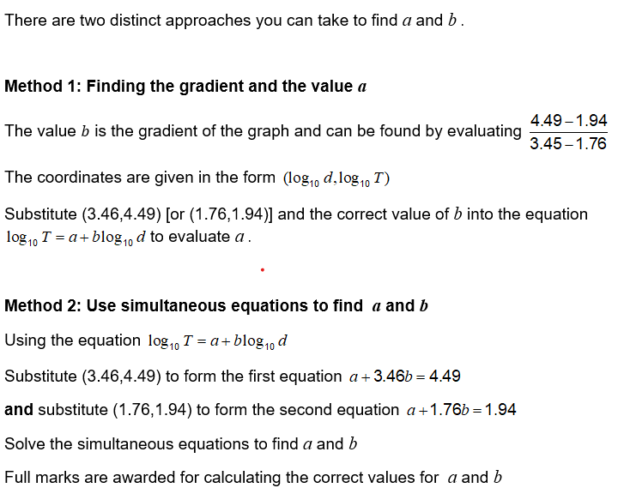
Question 7(a)(i)
Question | The examiner says

Slide 13
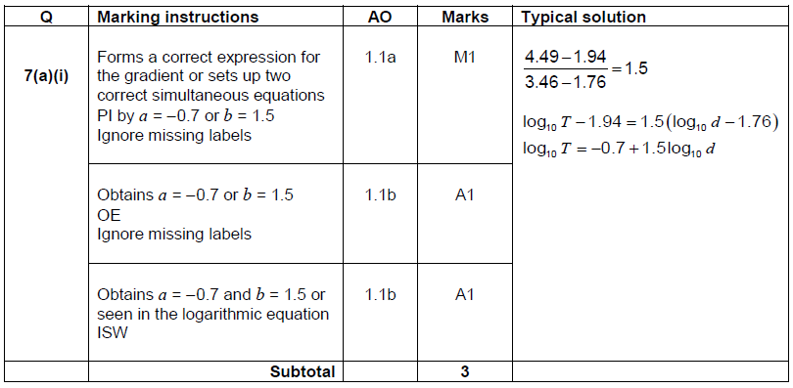
Question 7(a)(i)
Mark scheme

Slide 14
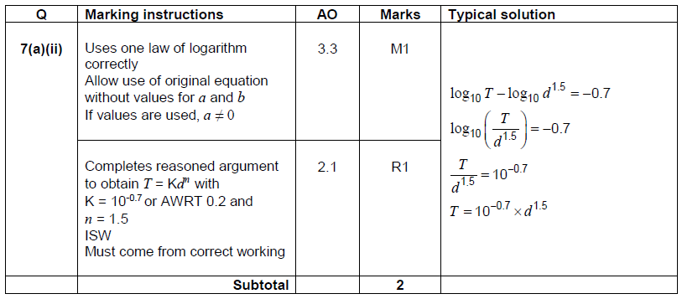
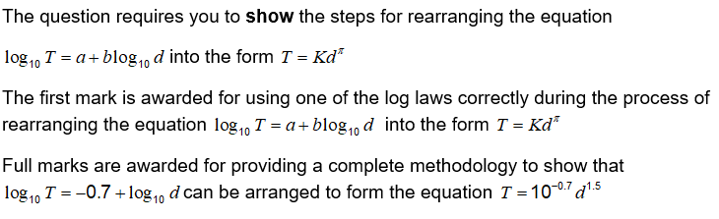
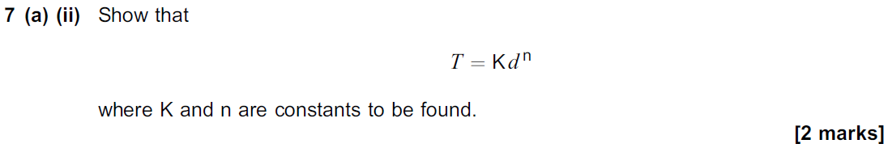
Question 7(a)(ii)
Question | Mark scheme
 | The examiner says

Slide 15
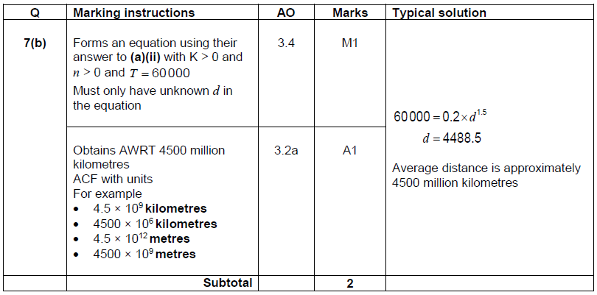

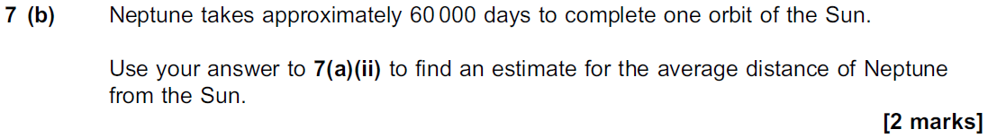
Question 7(b)
Question | Mark scheme
 | The examiner says

Slide 16
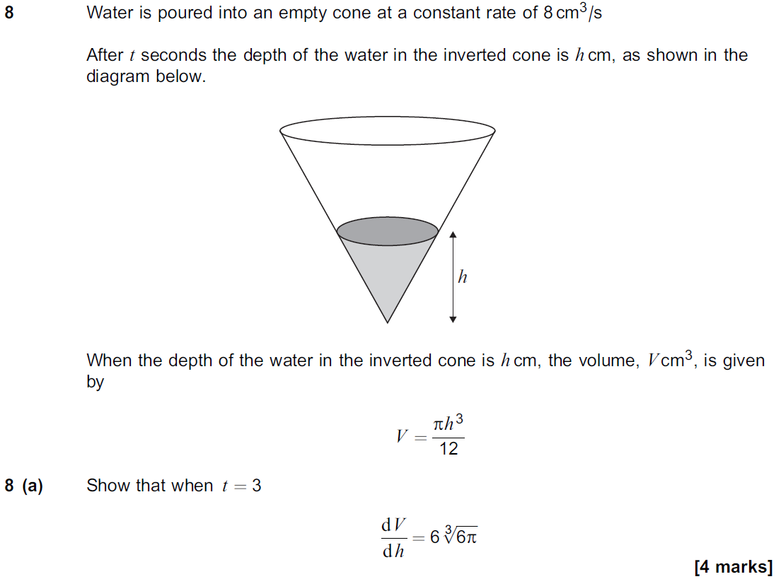
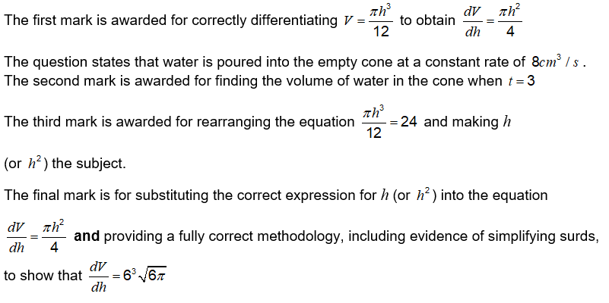
Question 8(a)
Question | The examiner says

Slide 17
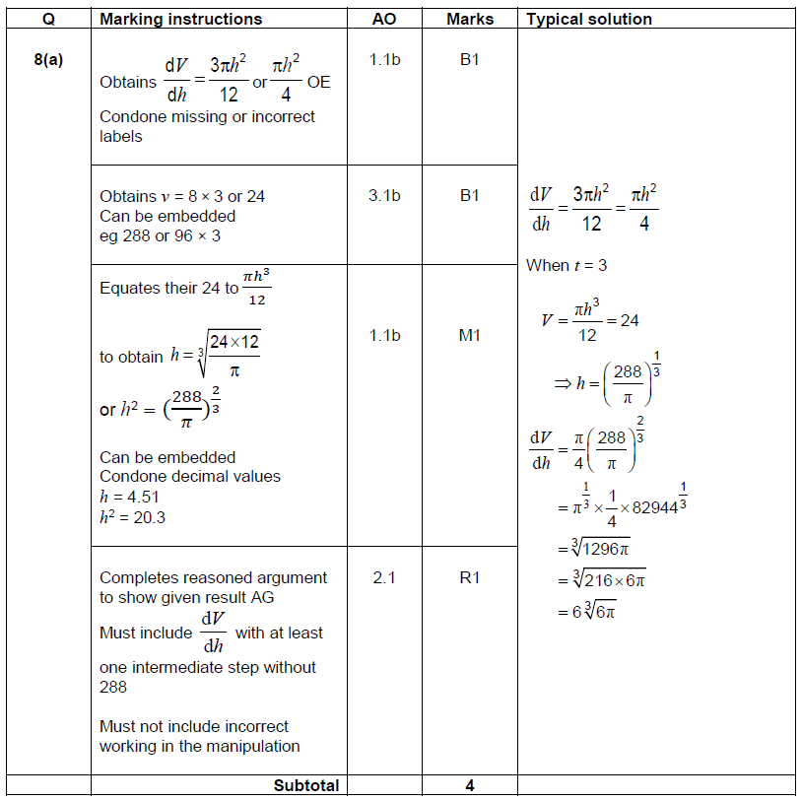
Question 8(a)
Mark scheme

Slide 18
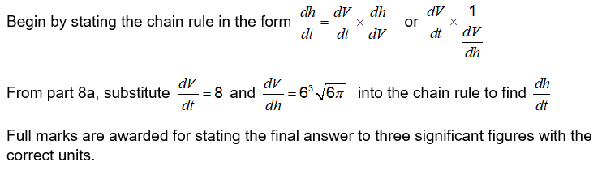
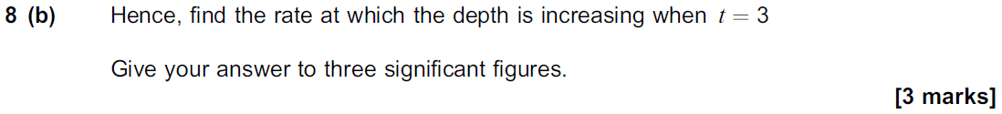
Question 8(b)
Question | The examiner says

Slide 19
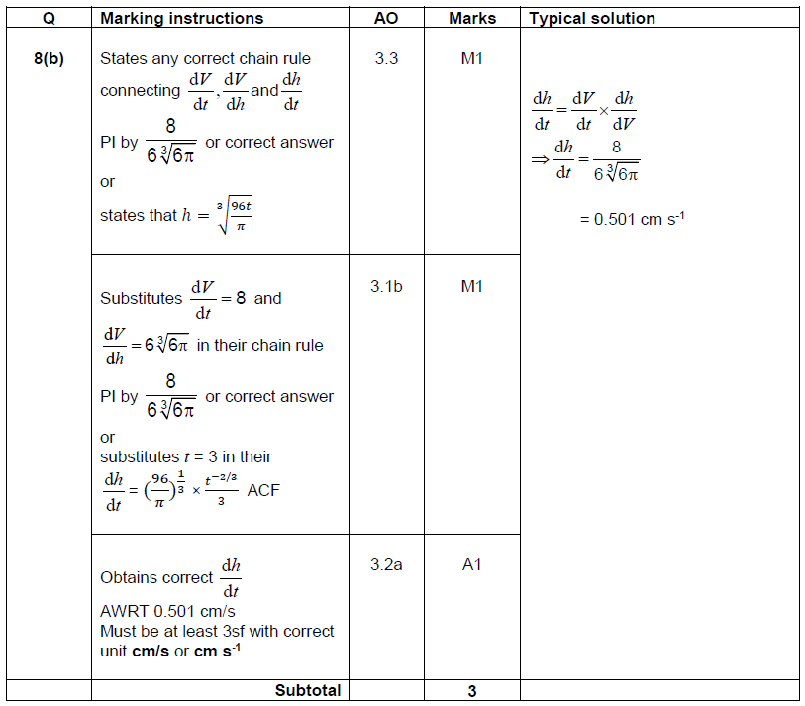
Question 8(b)
Mark scheme

Slide 20
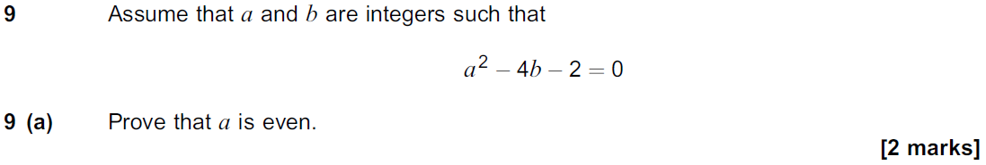
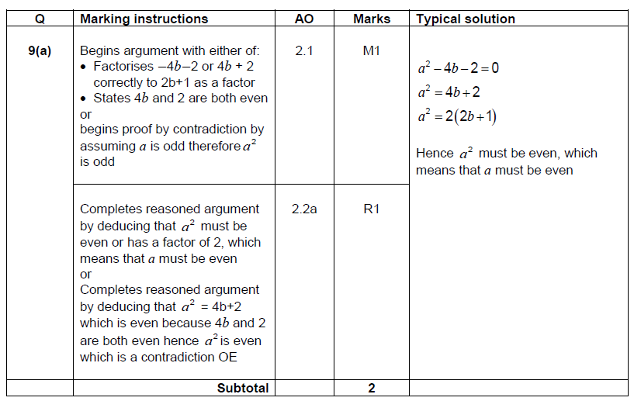
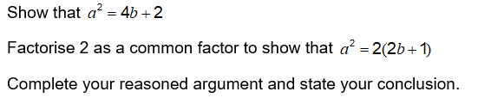
Question 9(a)
Question | Mark scheme
The examiner says

Slide 21
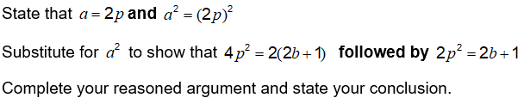
Question 9(b)
Question | The examiner says

Slide 22
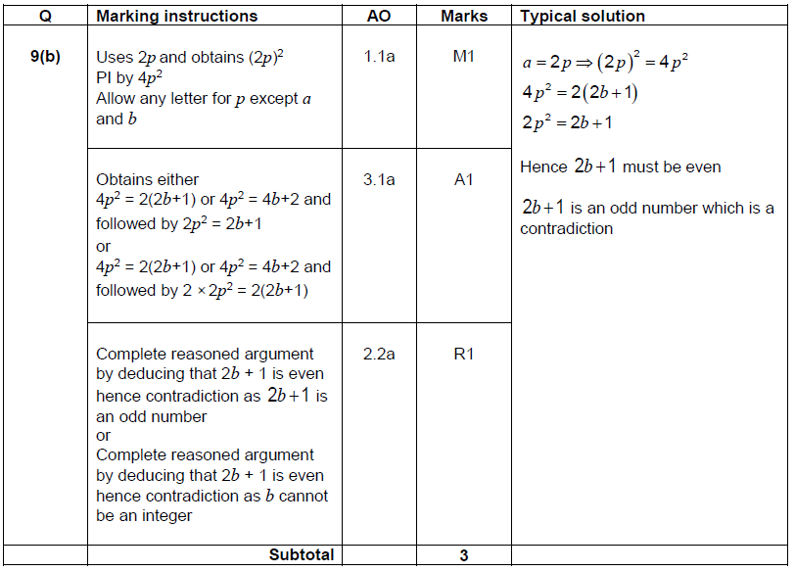
Question 9(b)
Mark scheme

Slide 23
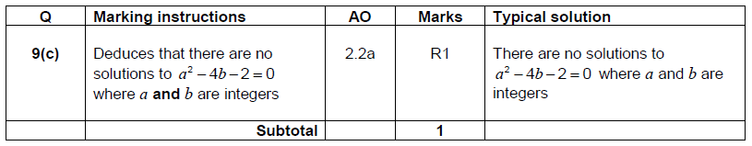
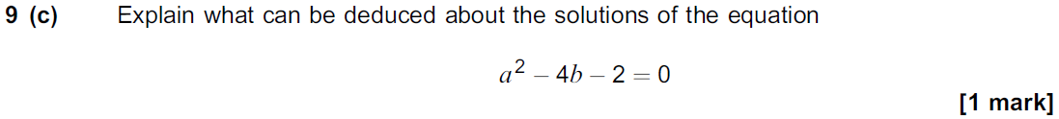
Question 9(c)
Question | Mark scheme
The examiner says

Slide 24
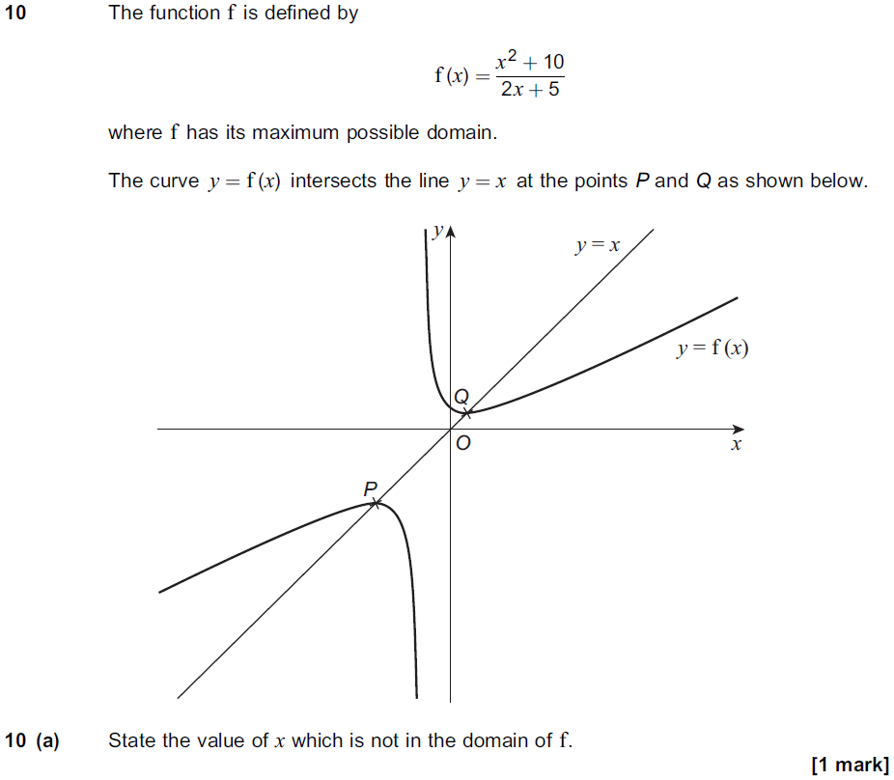
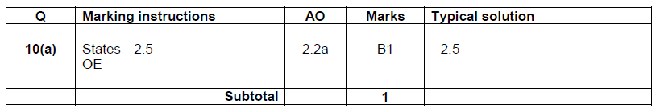

Question 10(a)
Question | Mark scheme
 | The examiner says

Slide 25
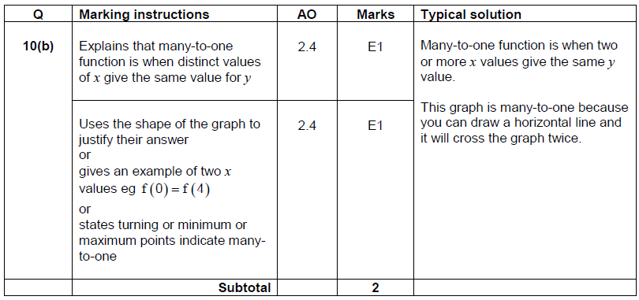
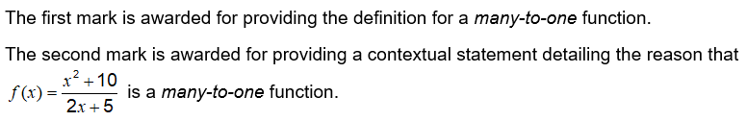
Question 10(b)
Question | Mark scheme
 | The examiner says

Slide 26



Question 10(c)(i)
Question | Mark scheme
 | The examiner says

Slide 27


Question 10(c)(ii)
Question | Mark scheme
 | The examiner says

Slide 28


Question 10(d)
Question | The examiner says

Slide 29



Question 10(d)
Mark scheme

Slide 30

Question 10(e)
Question | The examiner says

Slide 31

Question 10(e)
Mark scheme

Slide 32



Question 11
Question | Mark scheme
The examiner says

Slide 33



Question 12
Question | Mark scheme
The examiner says

Slide 34



Question 13
Question | Mark scheme
The examiner says

Slide 35



Question 14(a)
Question | Mark scheme
The examiner says

Slide 36



Question 14(b)(i)
Question | Mark scheme
The examiner says

Slide 37


Question 14(b)(ii)
Question | Mark scheme
The examiner says

Slide 38


Question 14(b)(iii)
Question | Mark scheme
The examiner says

Slide 39



Question 14(c)
Question | Mark scheme
The examiner says

Slide 40



Question 15(a)
Question | Mark scheme
The examiner says

Slide 41


Question 15(b)(i)
Question | Mark scheme
The examiner says

Slide 42


Question 15(b)(ii)
Question | Mark scheme
The examiner says

Slide 43




Question 16(a)
Question | Mark scheme
 | The examiner says

Slide 44



Question 16(b)(i)
Question | Mark scheme
 | The examiner says

Slide 45


Question 16(b)(ii)
Question | Mark scheme
 | The examiner says

Slide 46


Question 16(b)(iii)
Question | Mark scheme
 | The examiner says

Slide 47


Question 16(c)
Question | The examiner says

Slide 48

Question 16(c)
Mark scheme

Slide 49


Question 17
Question | The examiner says

Slide 50



Question 17
Mark scheme

Slide 51


Question 18(a)
Question | The examiner says

Slide 52

Question 18(a)
Mark scheme

Slide 53



Question 18(b)(i)
Question | Mark scheme
The examiner says

Slide 54


Question 18(b)(ii)
Question | Mark scheme
The examiner says

Slide 55


Question 18(b)(iii)
Question | Mark scheme
The examiner says

Slide 56



Question 18(c)
Question | Mark scheme
The examiner says

Slide 57

Question 18(d)
Question | The examiner says

Slide 58

Question 18(d)
Mark scheme

Slide 59


Question 19
Question | The examiner says

Slide 60


Question 19
Mark scheme

